Slide 1
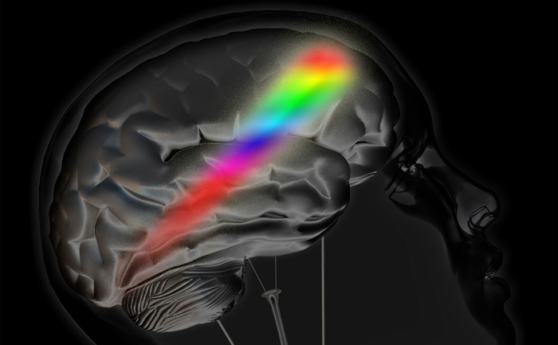
Color memory Task
With Color Complexity
Azim Chyngozhoev 20212003

Slide 2
Introduction
Iconic memory
Thomas Sanocki, Noah Sulman “color relations” experiment

Slide 3
Introduction
Iconic memory
Thomas Sanocki, Noah Sulman “color relations” experiment

Slide 4
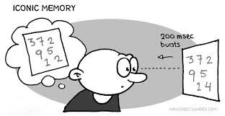
Introduction
Iconic memory
Thomas Sanocki, Noah Sulman “color relations” experiment

Slide 5
Introduction
Iconic memory
Thomas Sanocki, Noah Sulman “color relations” experiment

Slide 6
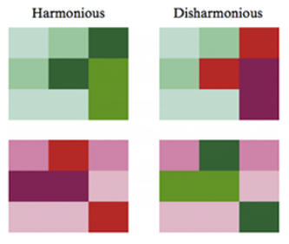
Introduction
Iconic memory
Thomas Sanocki, Noah Sulman “color relations” experiment
Harmonious colors are more appealing, thus, easier to remember.

Slide 7

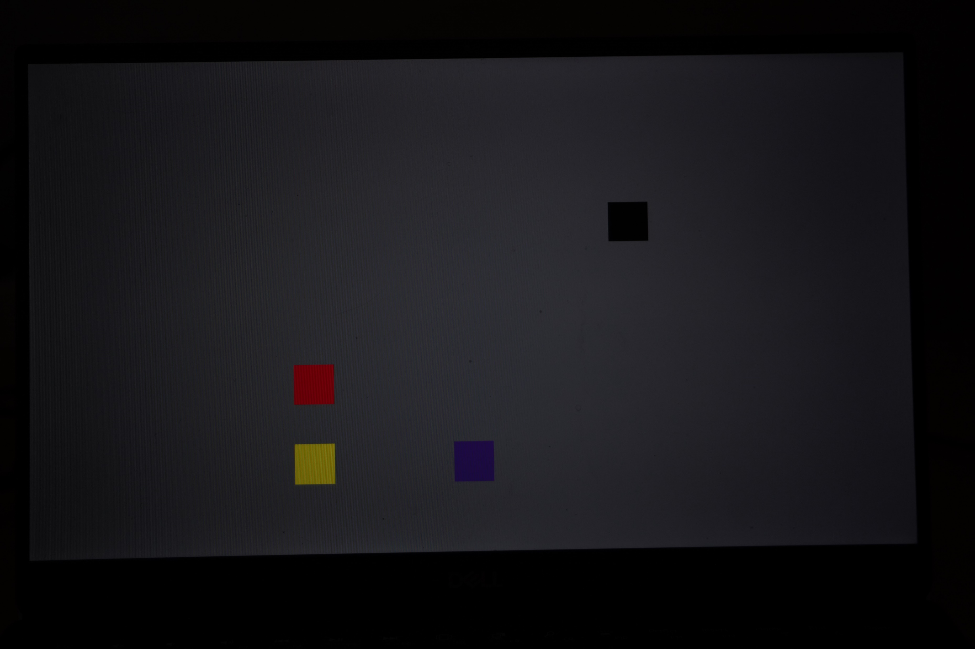

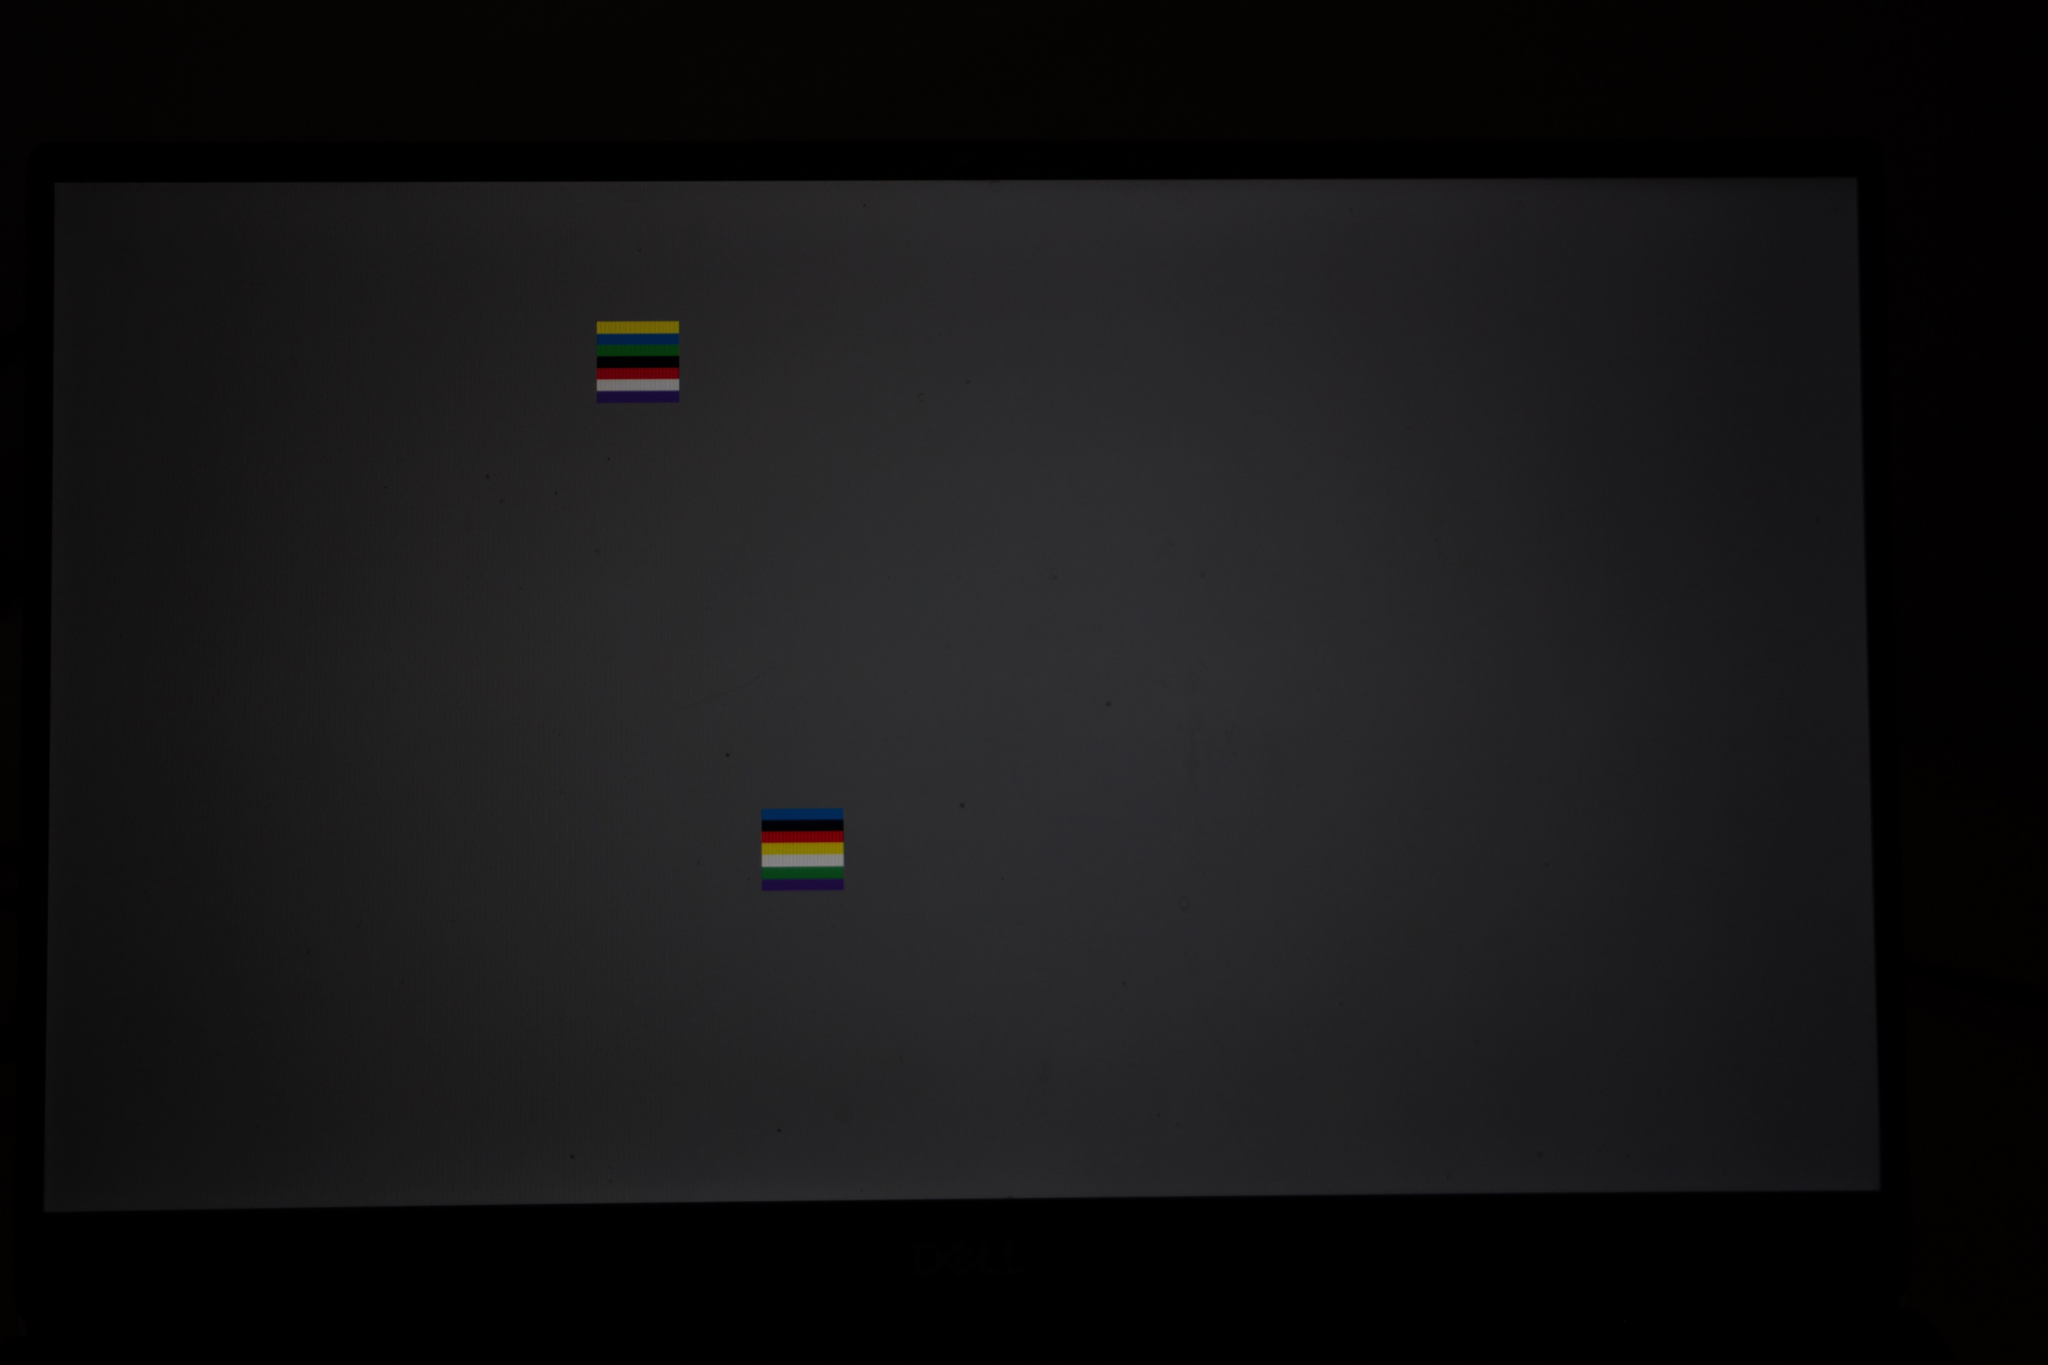

Methods

Slide 8


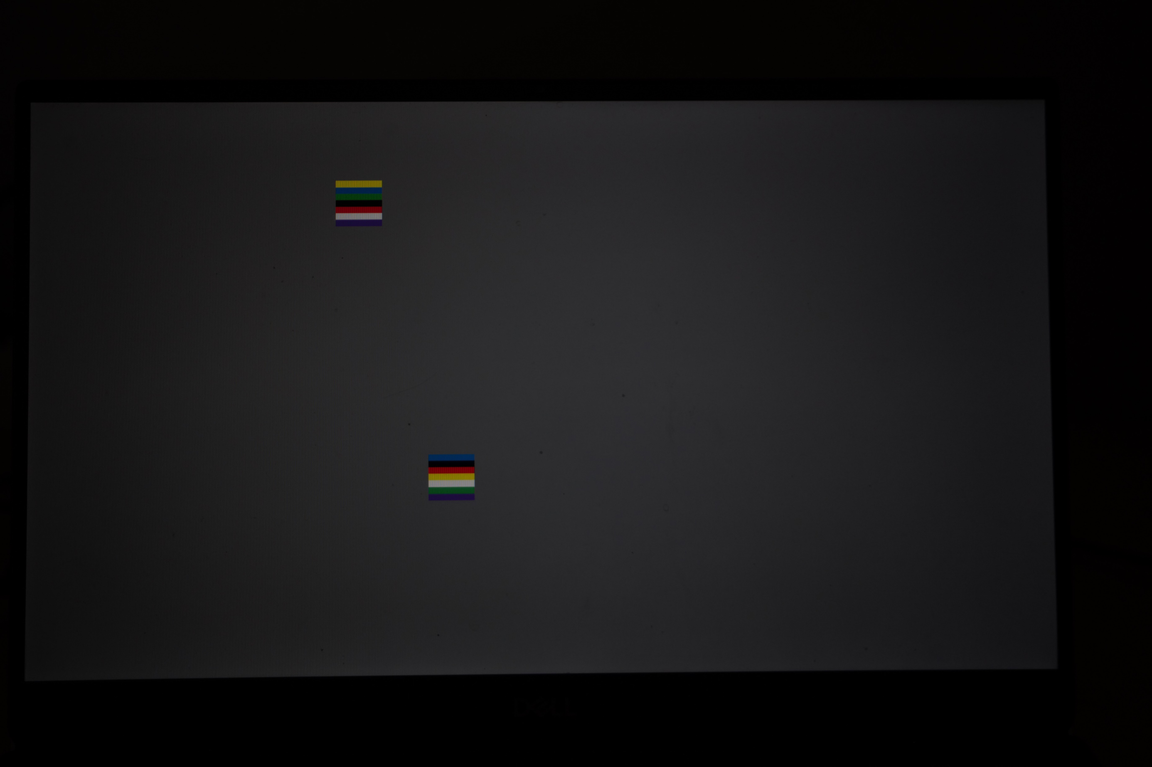

Methods
Fixation
Encoding
Mask
Cue

Slide 9
Methods
Fixation 0.5s
Encoding
Mask
Cue

Slide 10
Methods
Fixation
Encoding 0.5s
Mask
Cue

Slide 11
Methods
Fixation
Encoding
Mask 0.5s
Cue

Slide 12
Methods
Fixation
Encoding
Mask
Cue “yes” or “no”

Slide 13
Methods
0 – 30 trials are inharmonious
30 – 40 trials are harmonious red
40 – 50 trials are harmonious green
50 – 60 trials are harmonious blue
60 – 70 trails are inharmonious

Slide 14

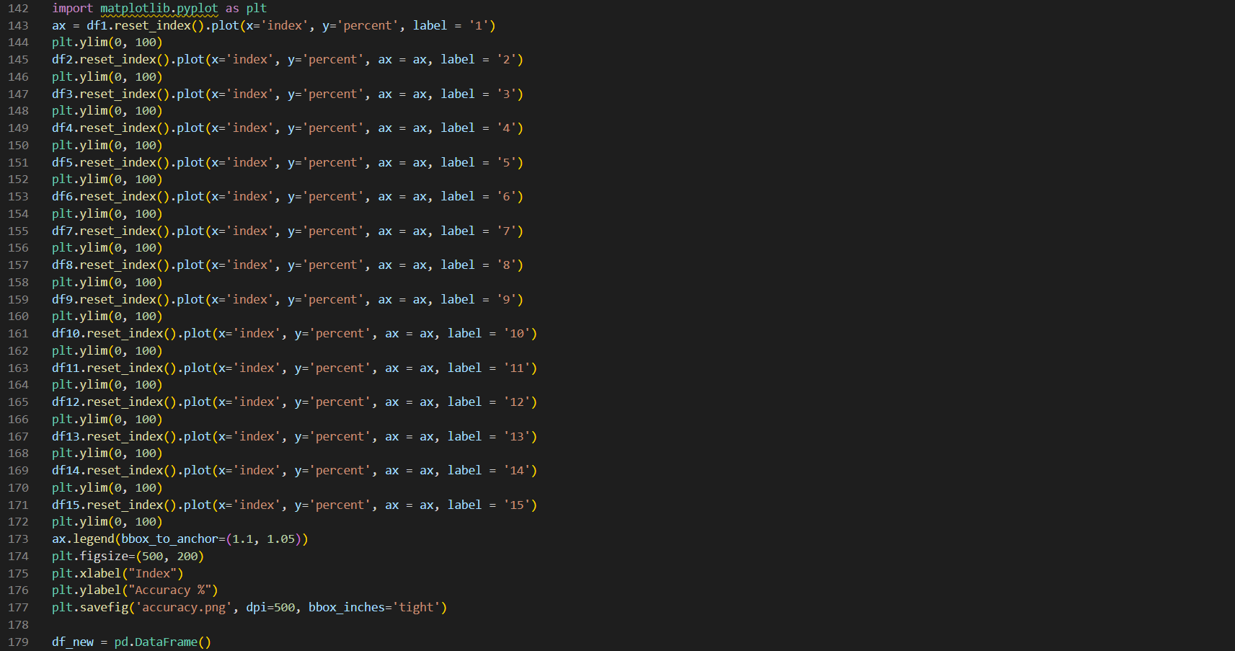

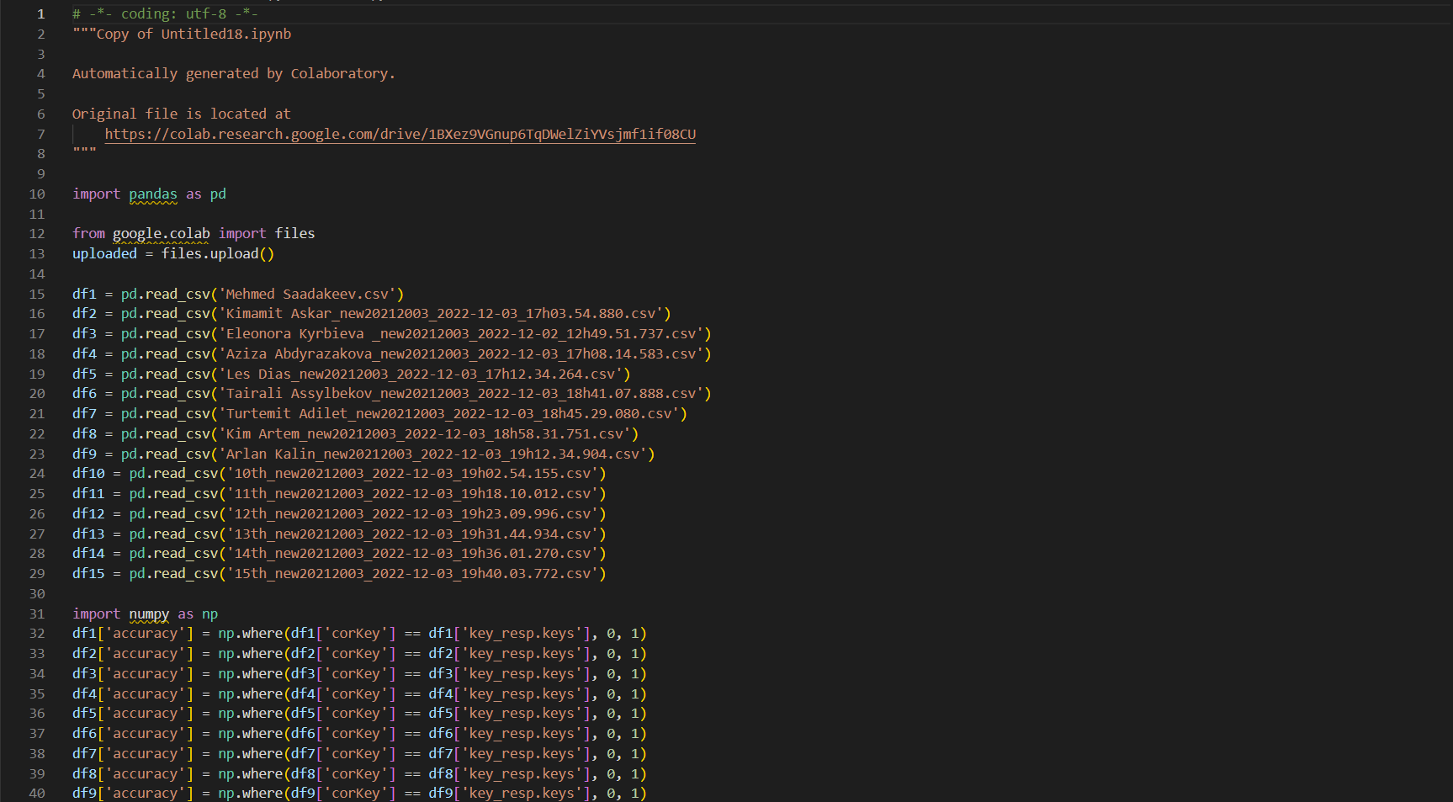
Data Processing Results

Slide 15
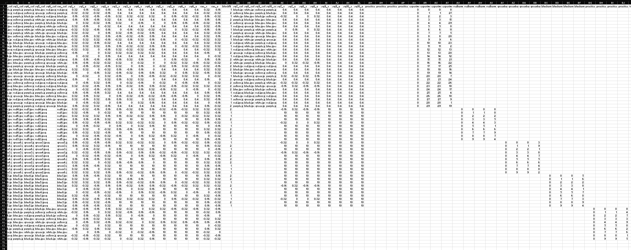
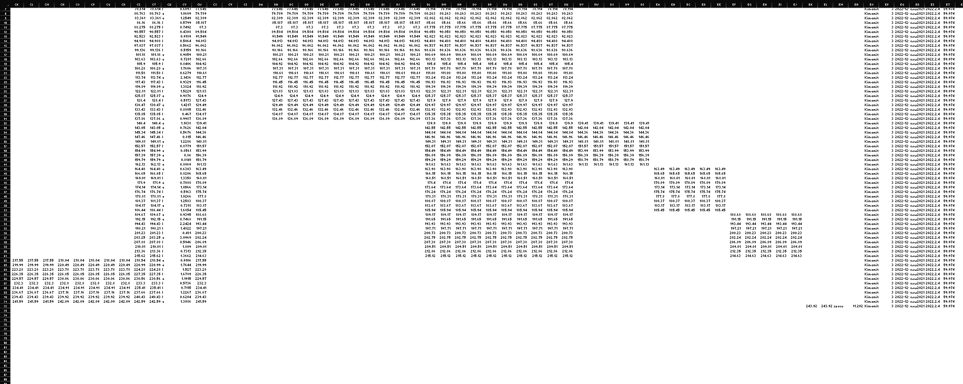
Data
Each 150 x 71
Which colors displayed
Positions of squares
Exact time of display
Reaction Time
Key response
Correct response

Slide 16
Data Processing
Not easy…
3 hours spent…
Google colab
Pandas Dataframe, Matplotlib, Numpy,

Slide 17
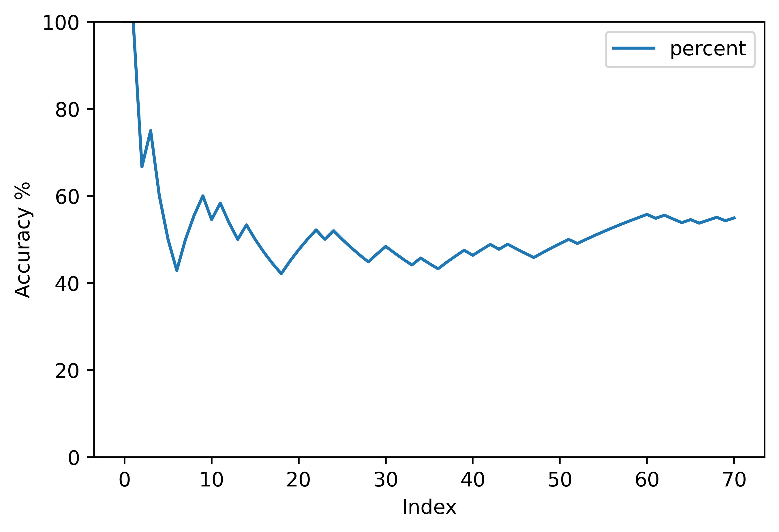
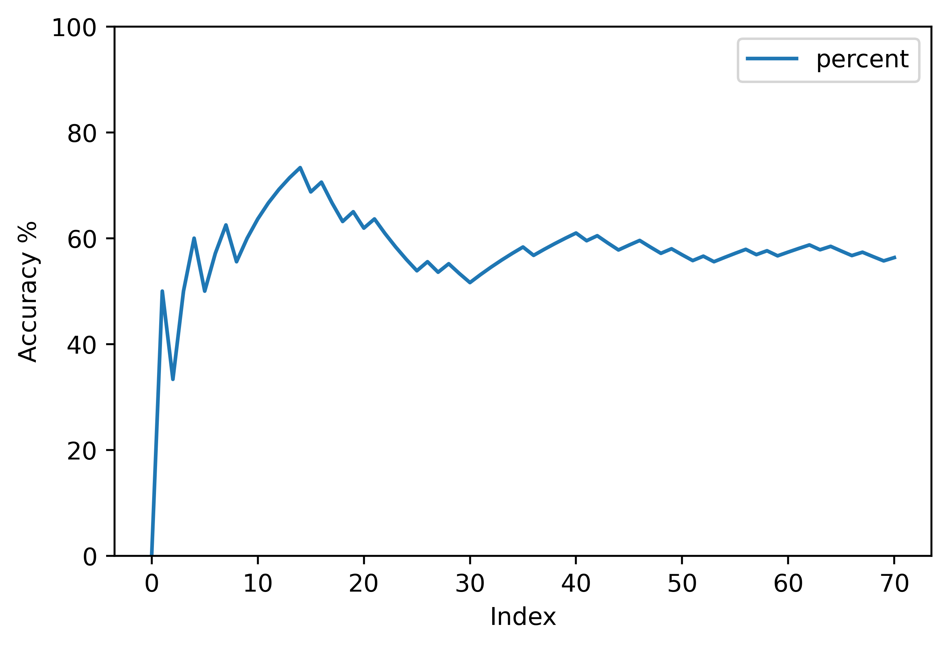
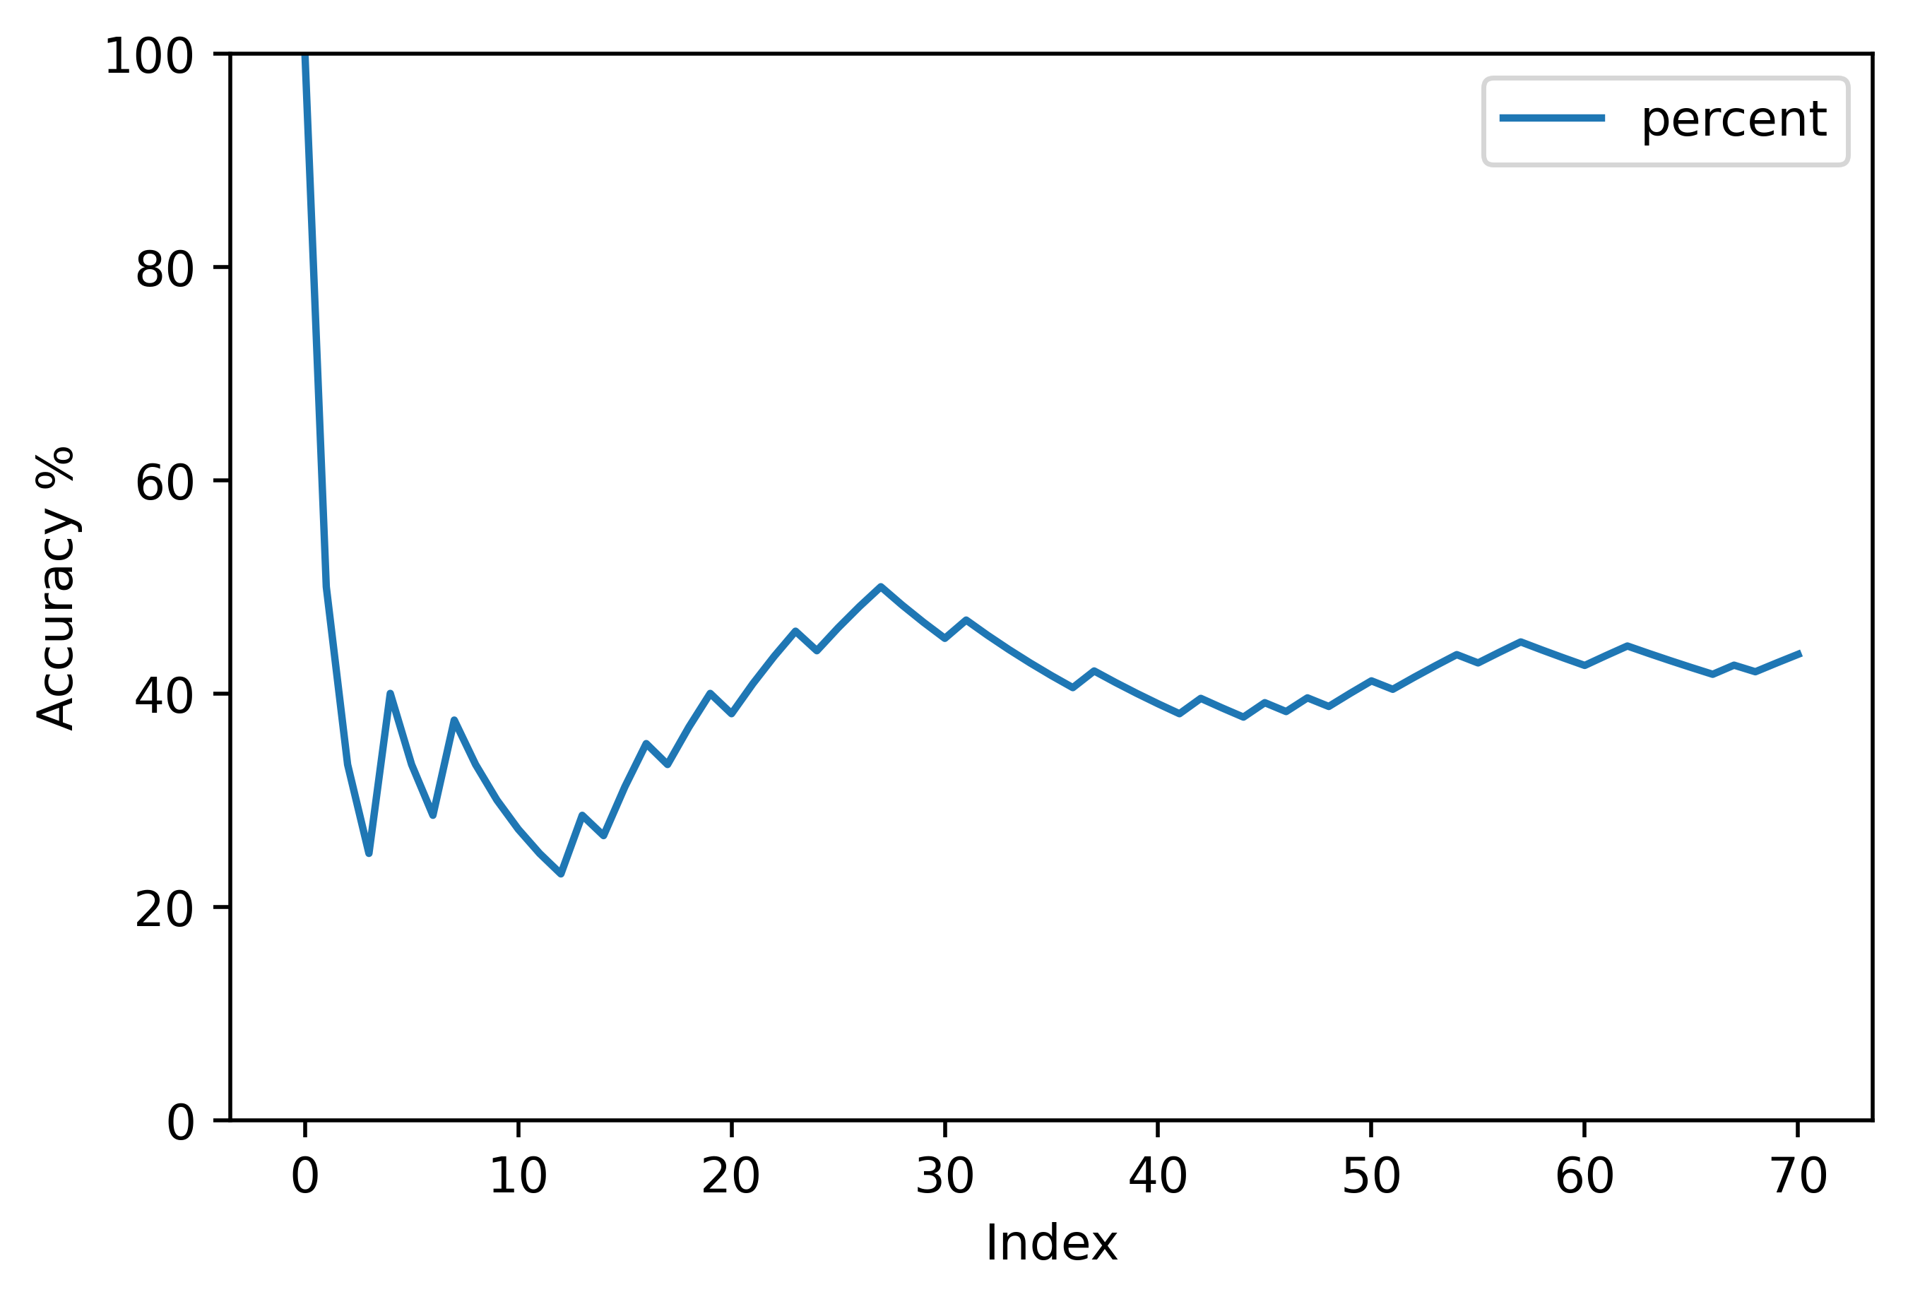
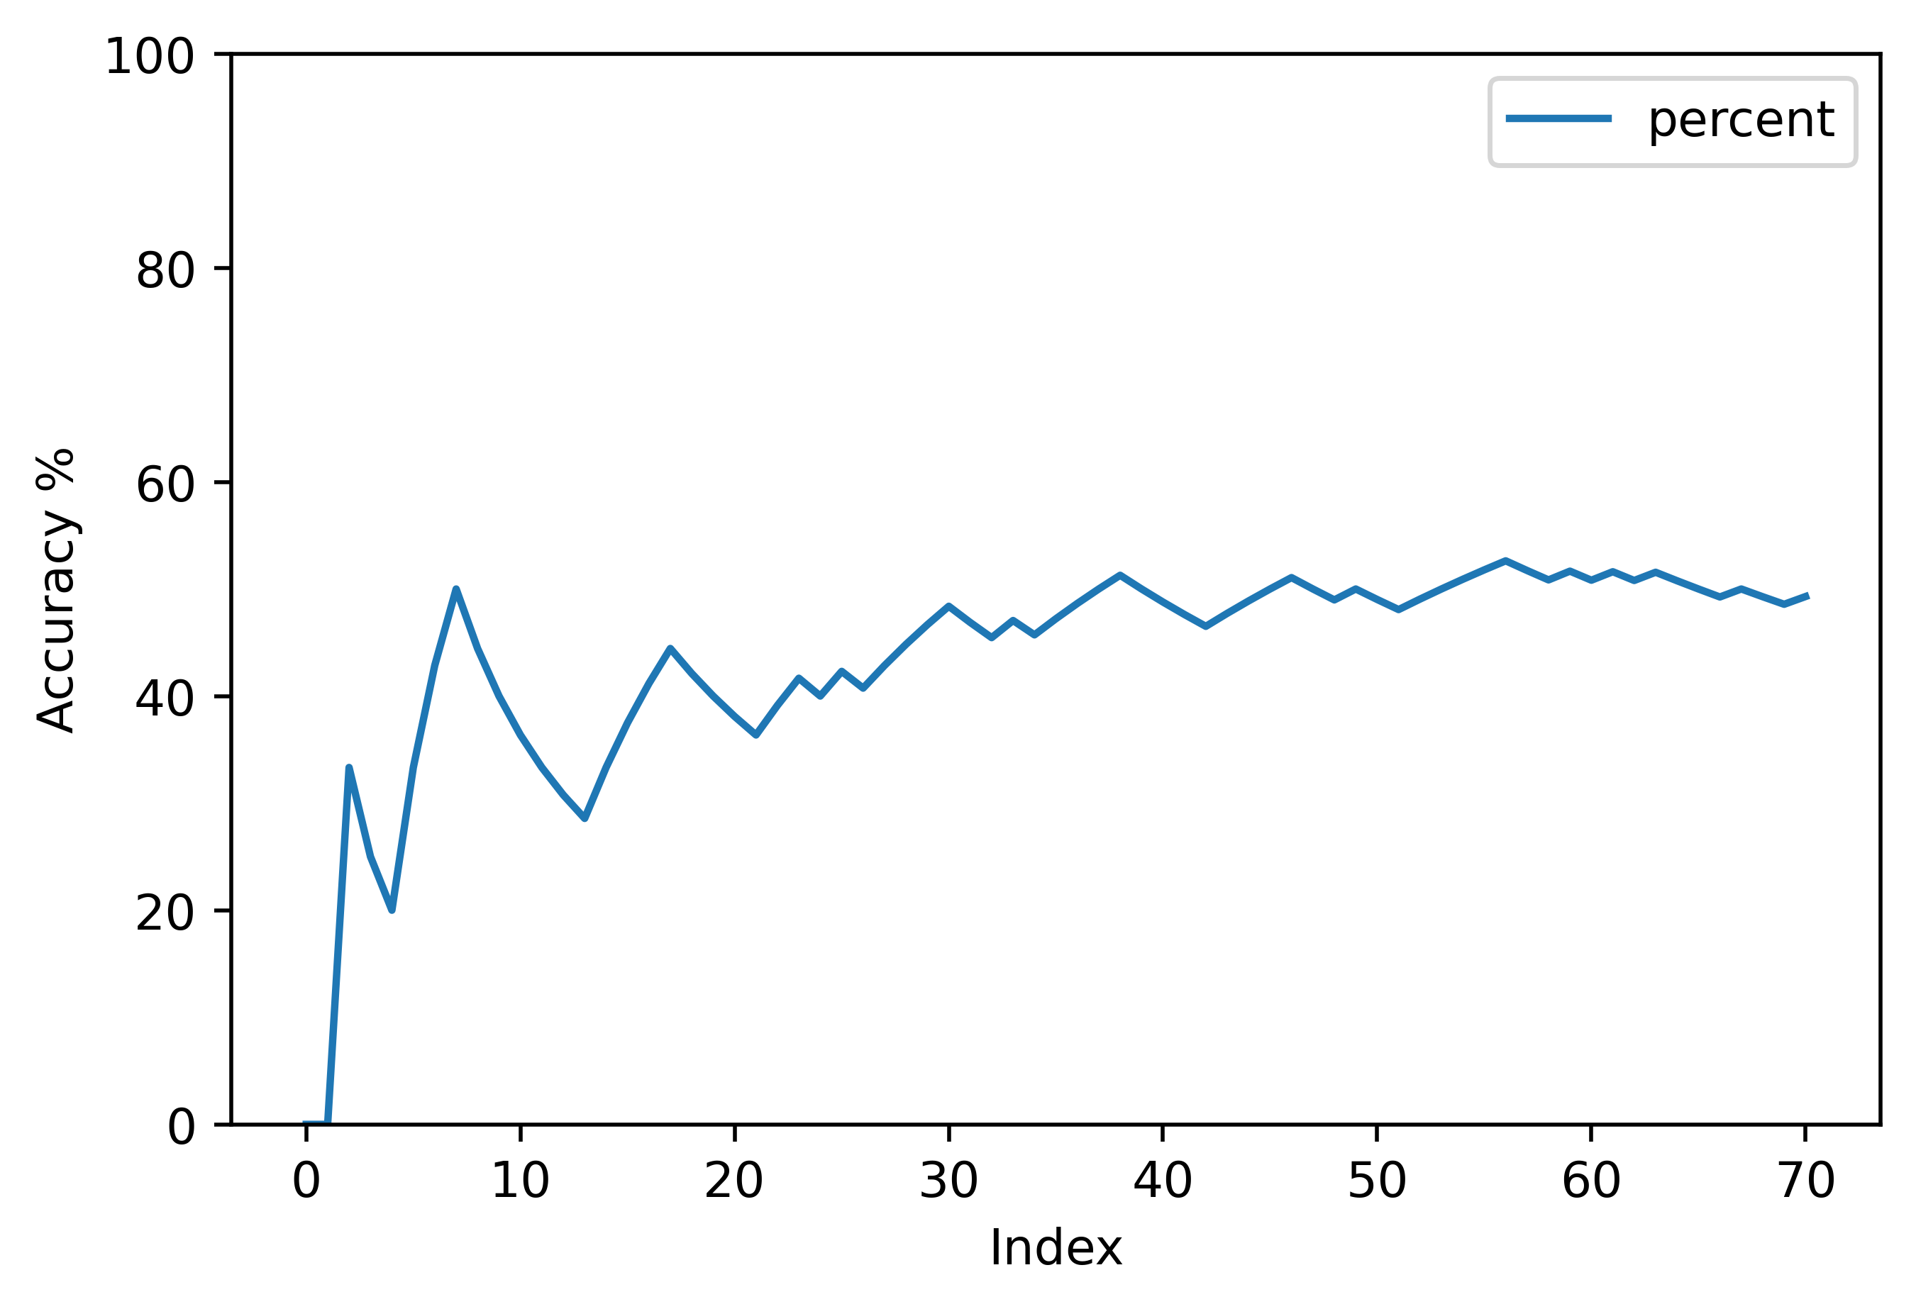
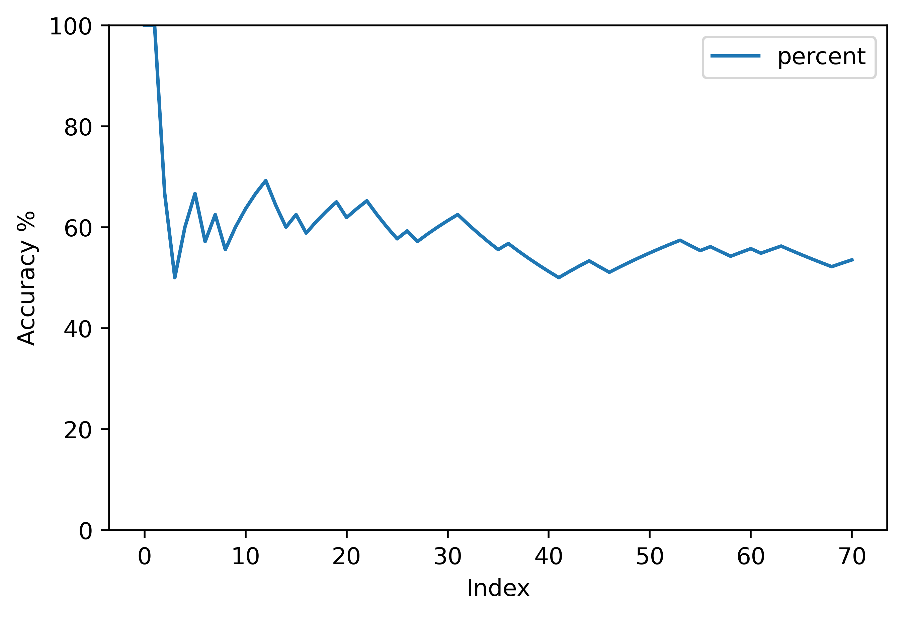
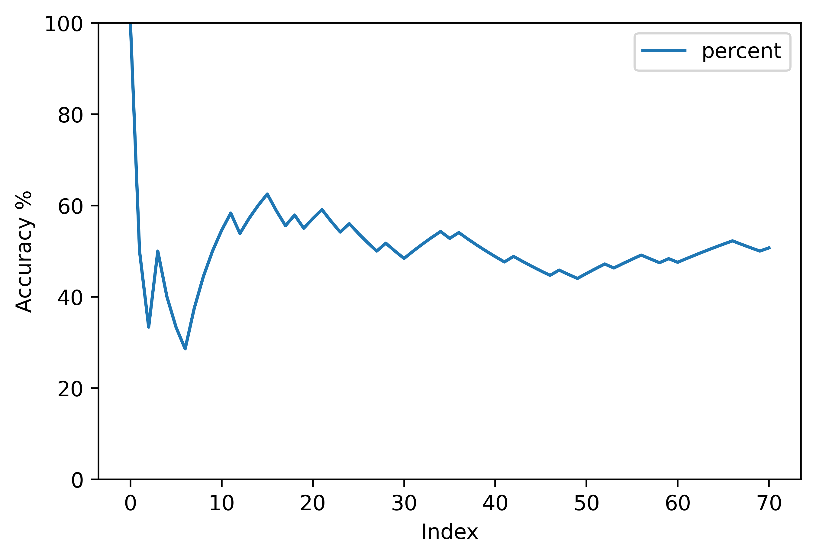
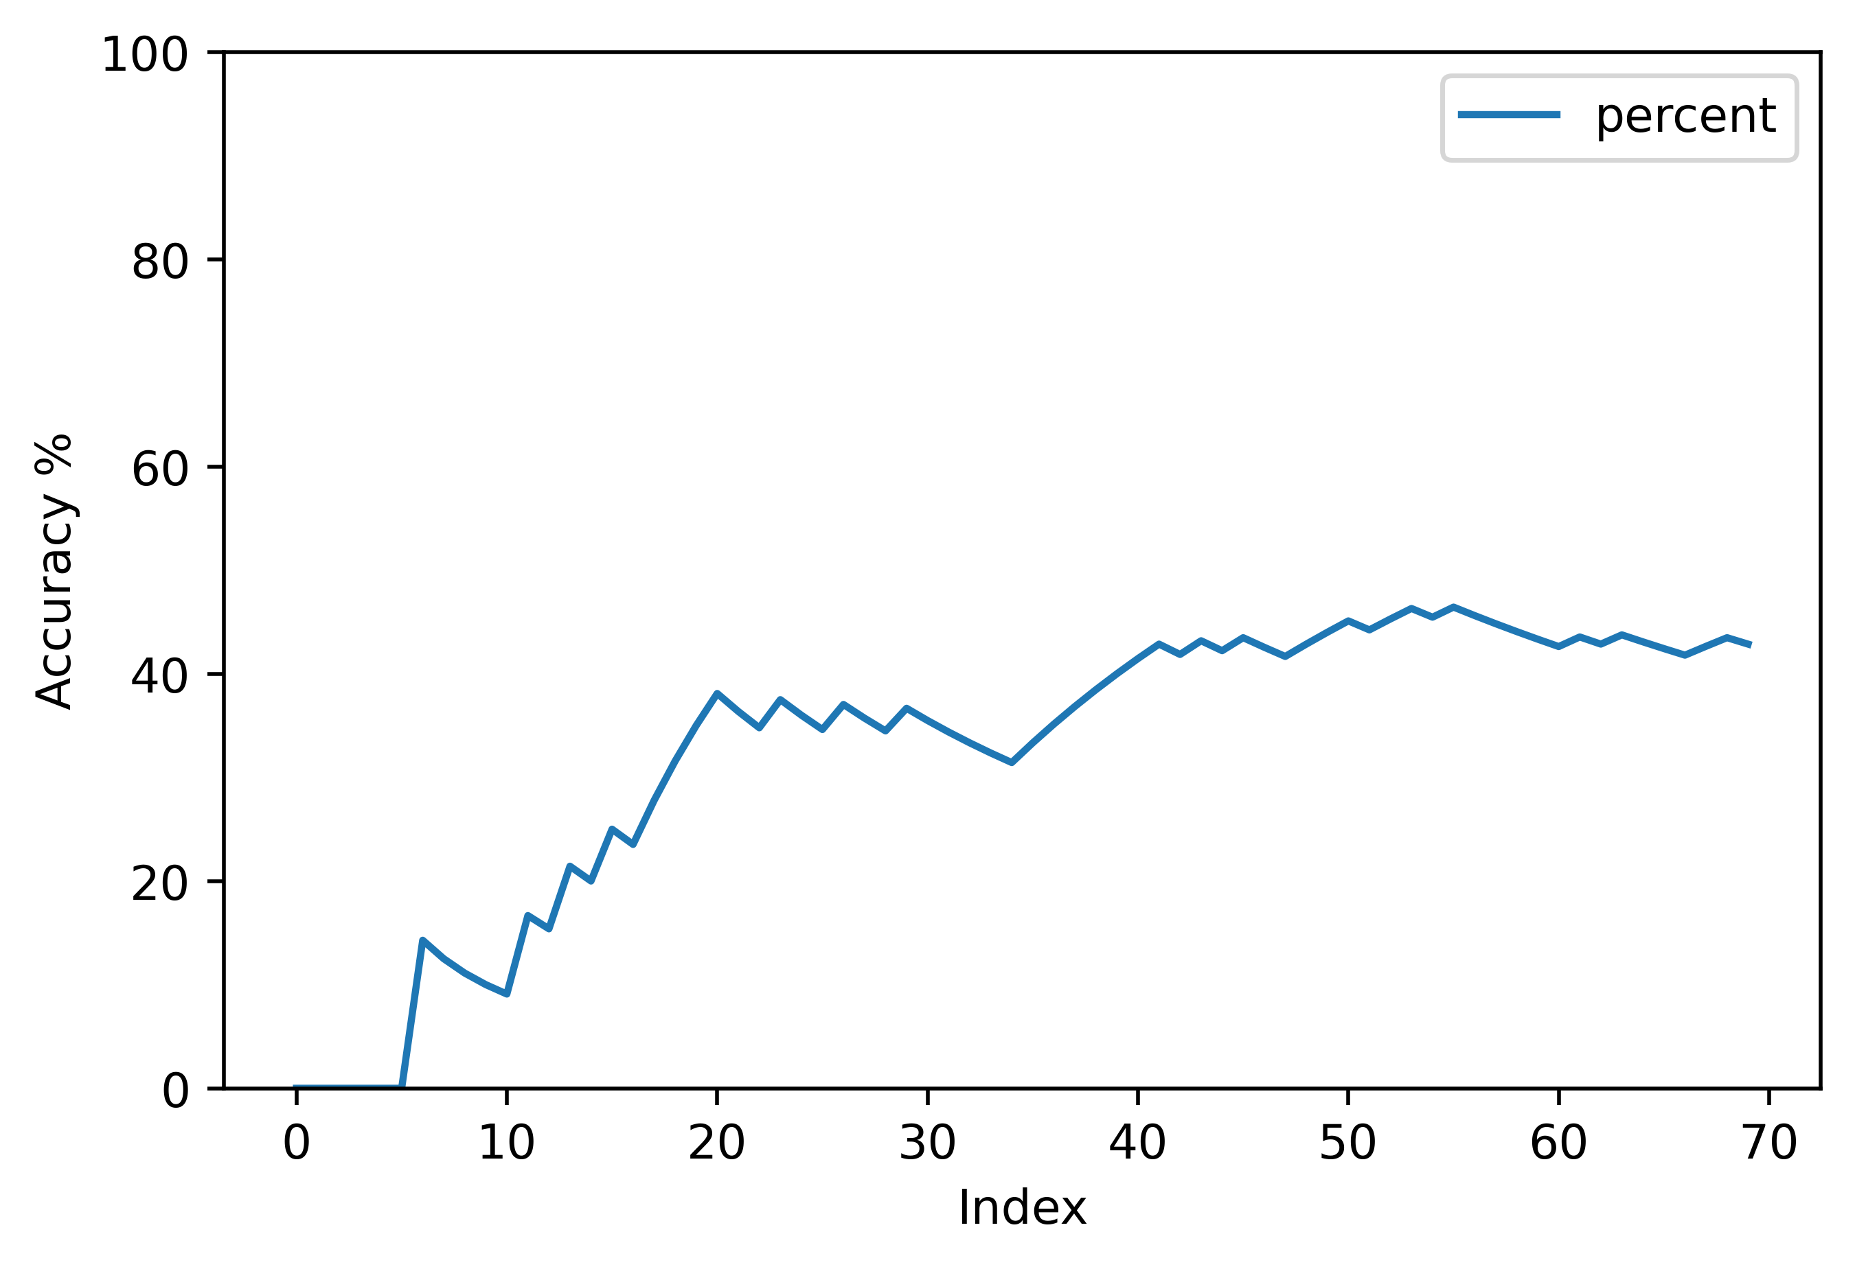
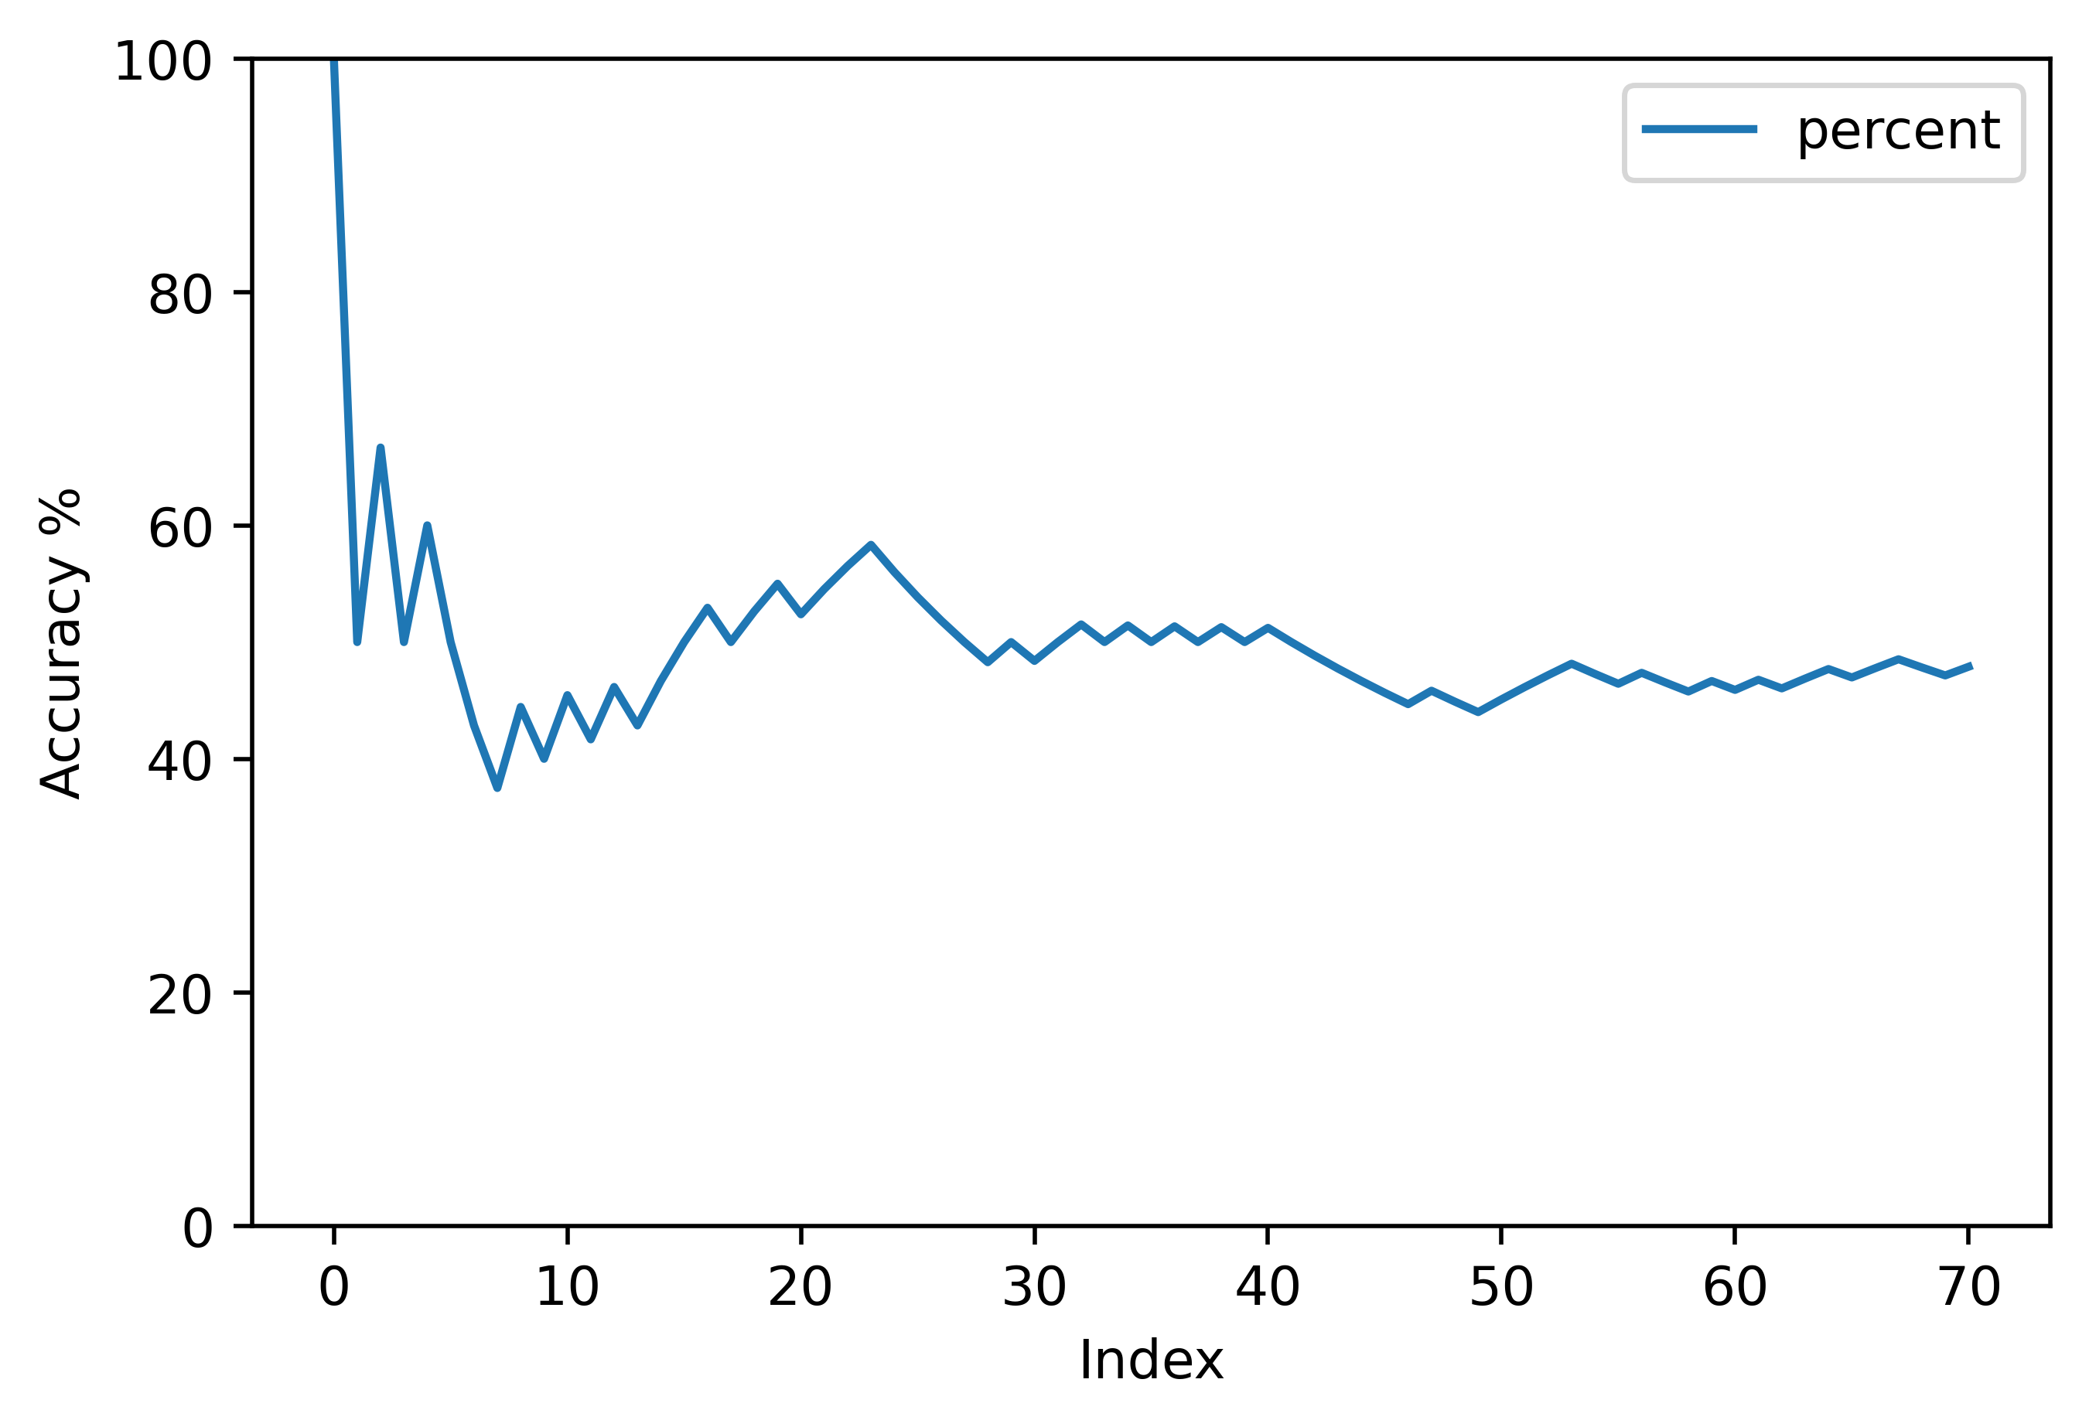
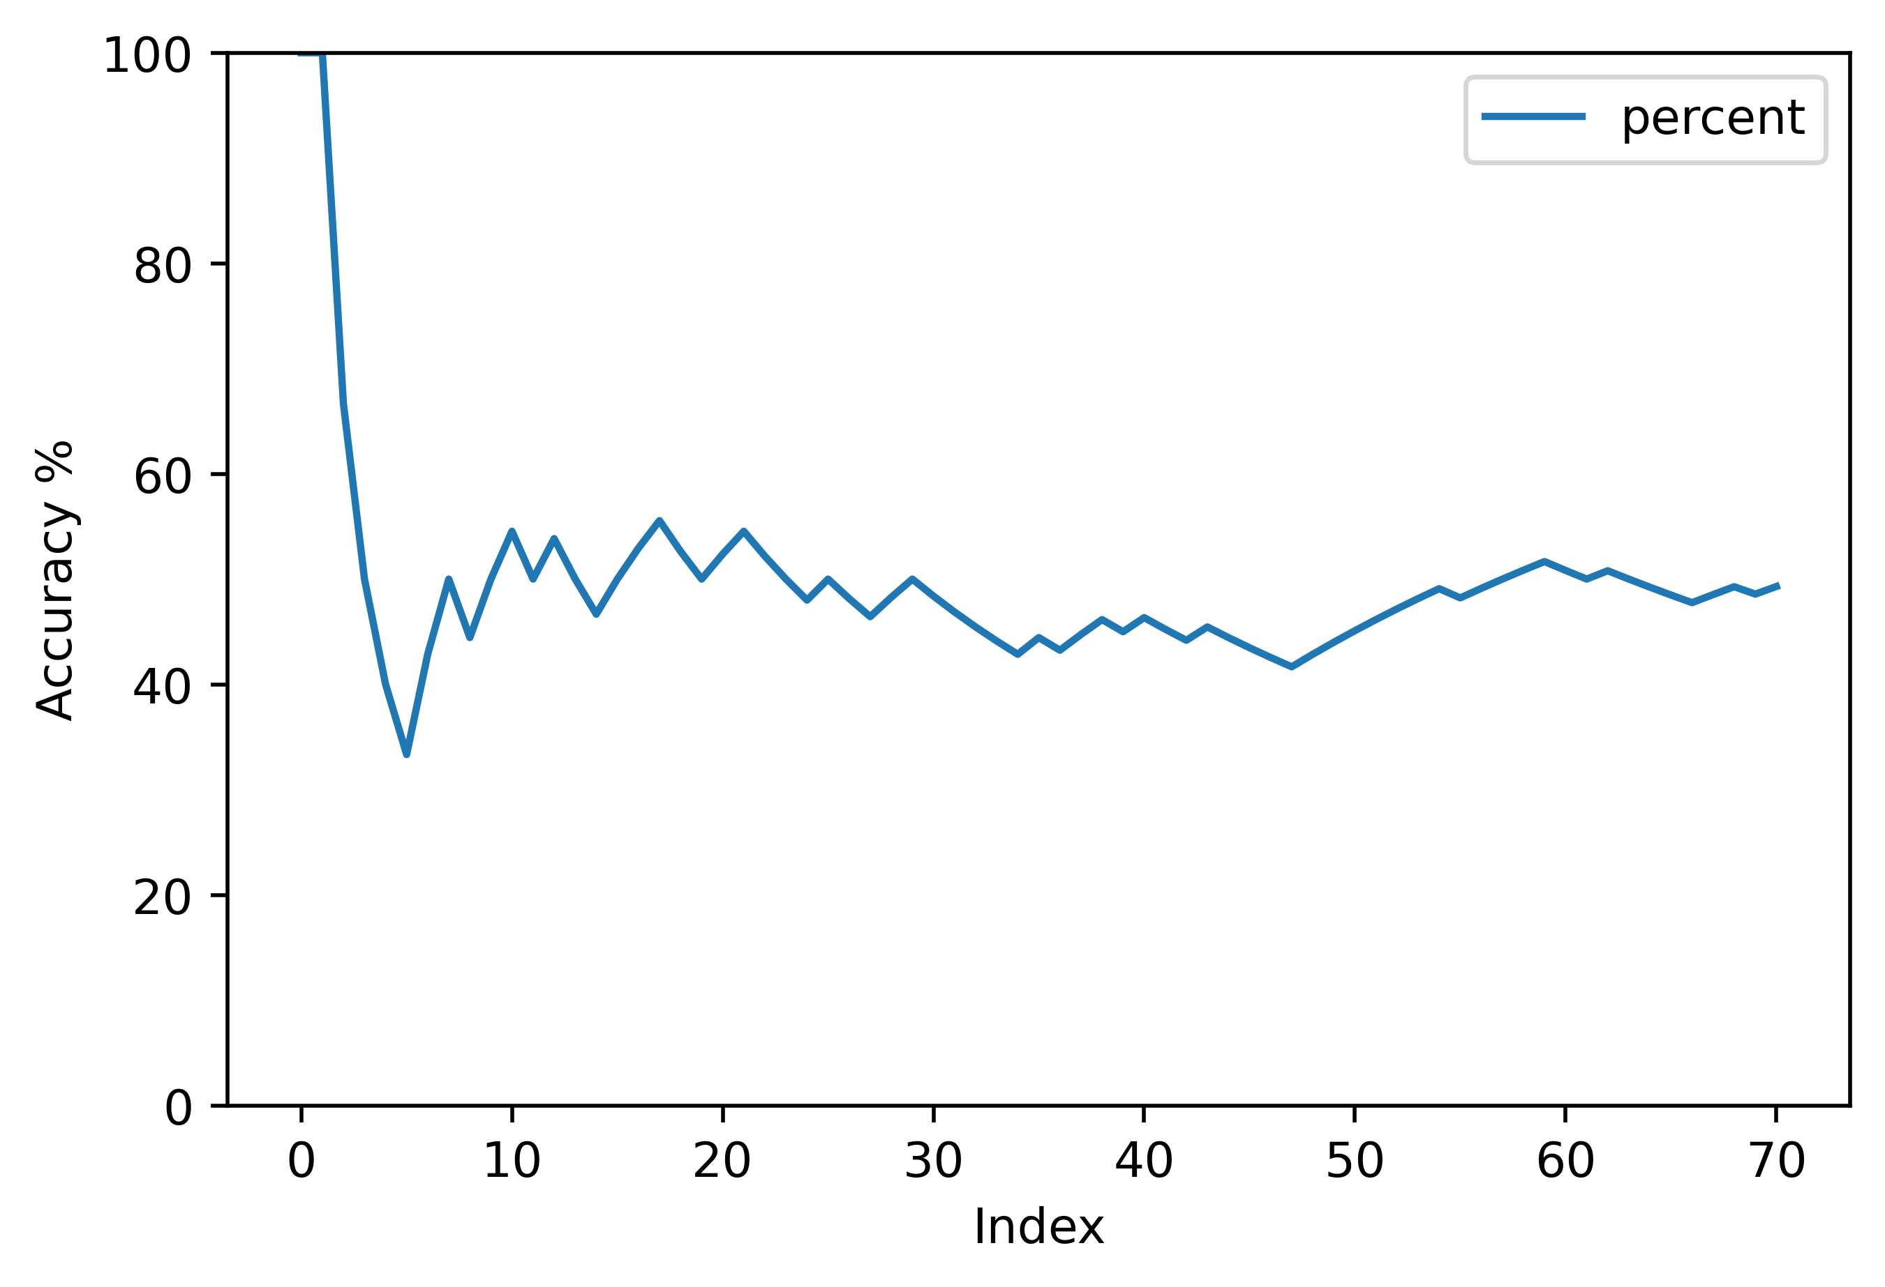
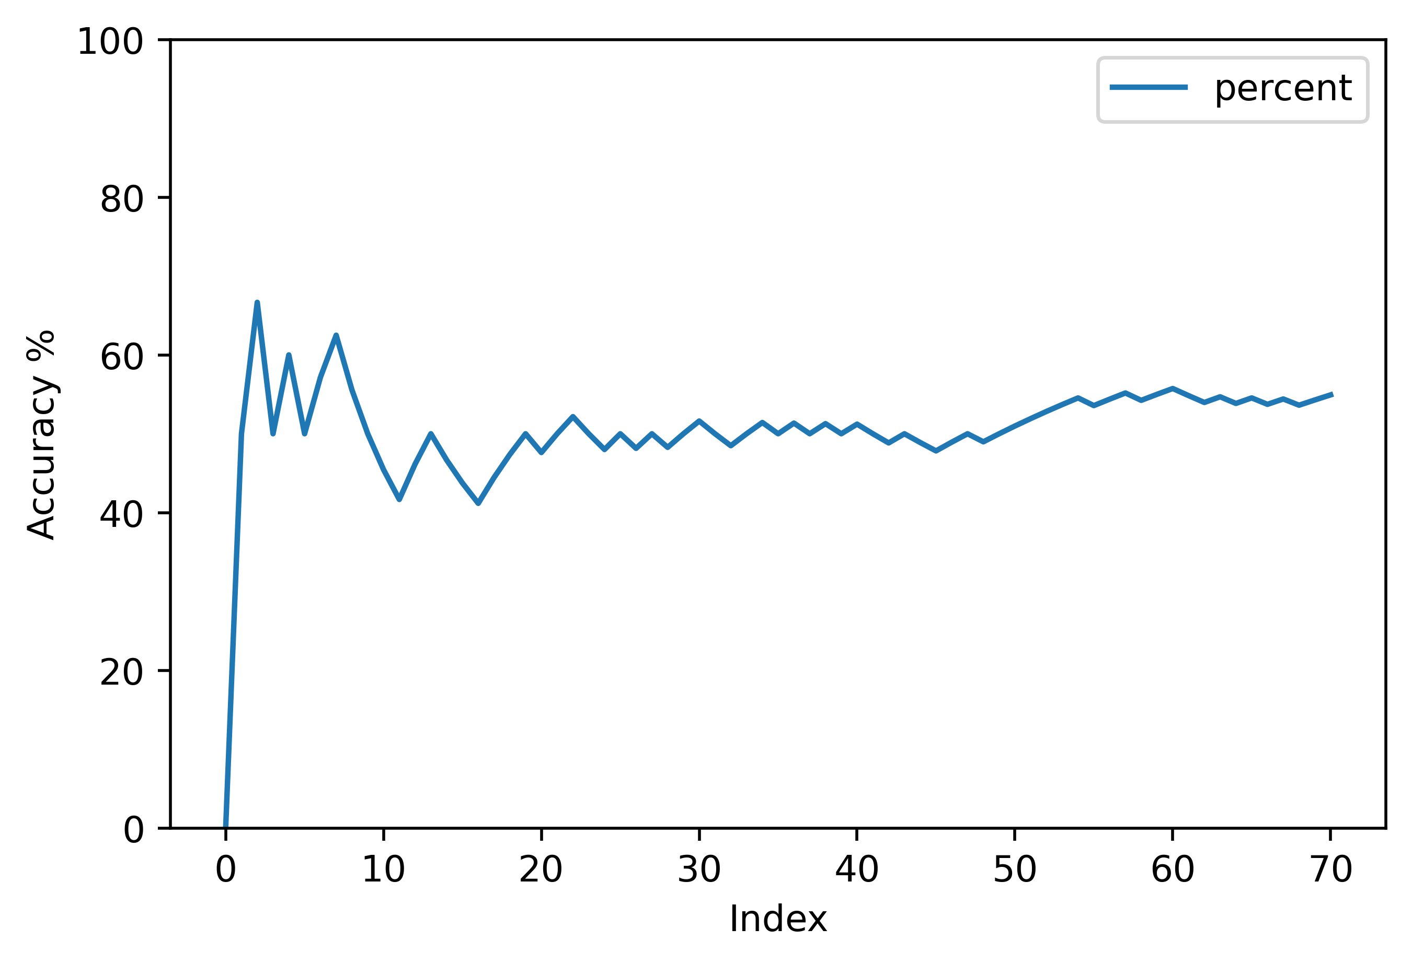
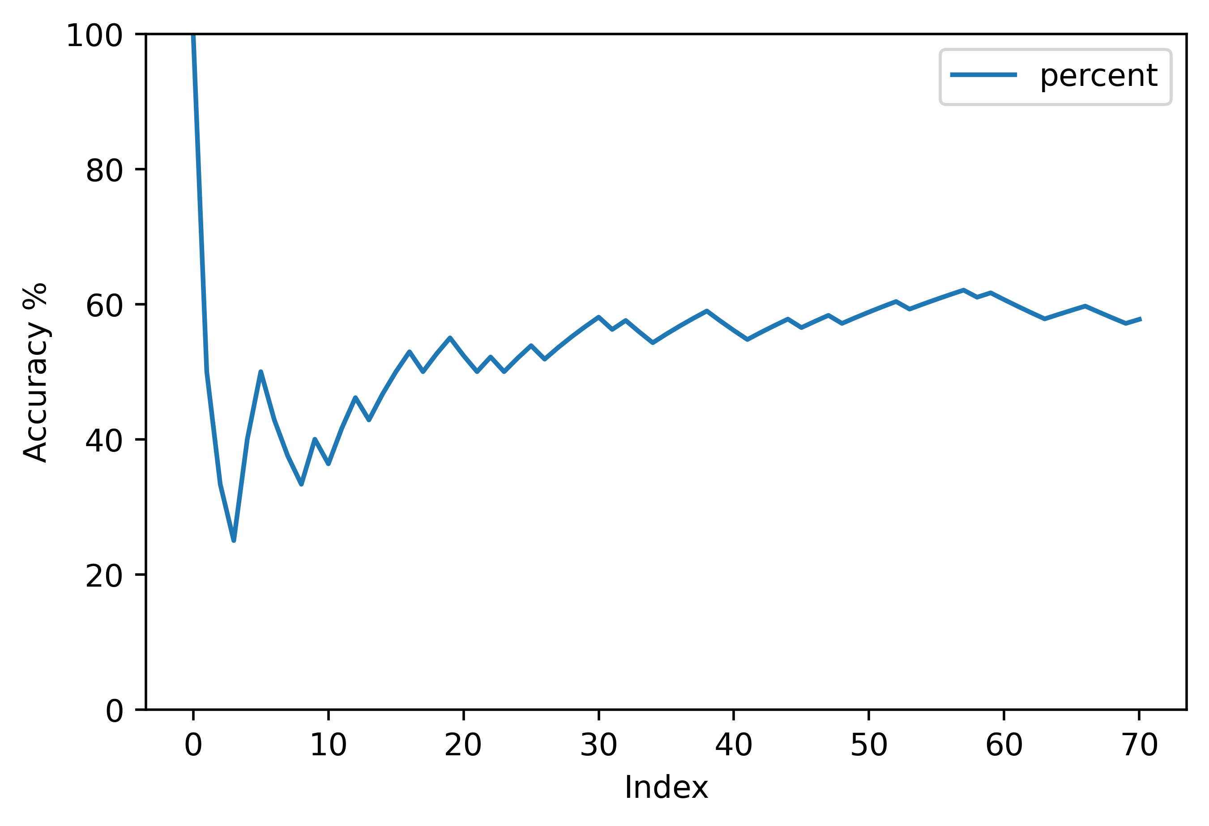
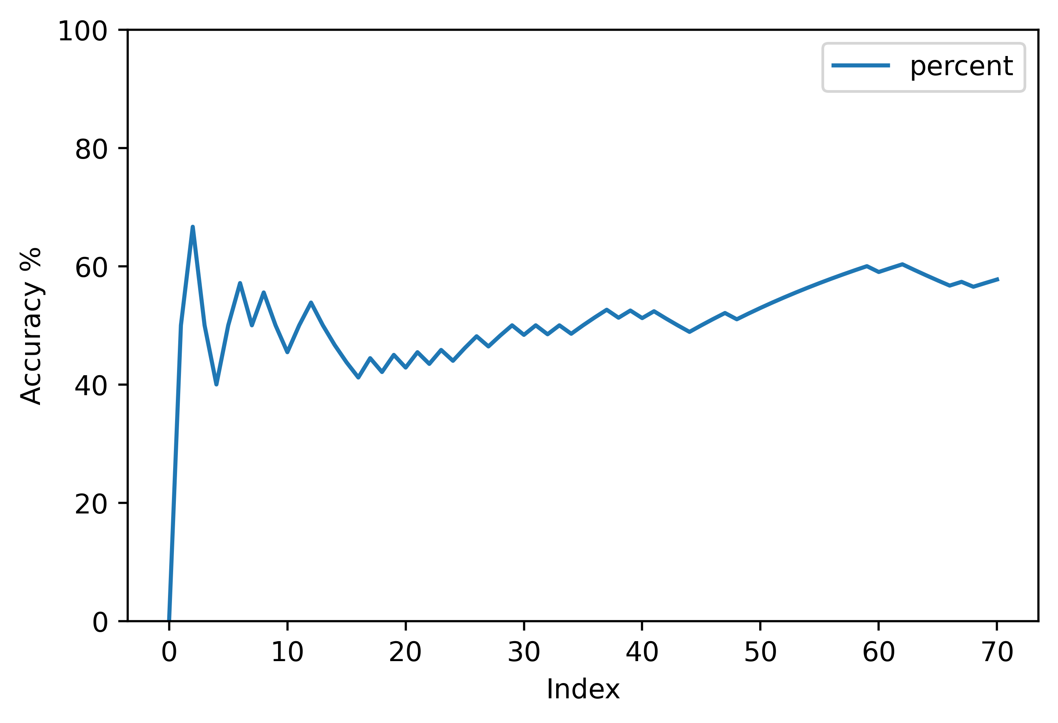
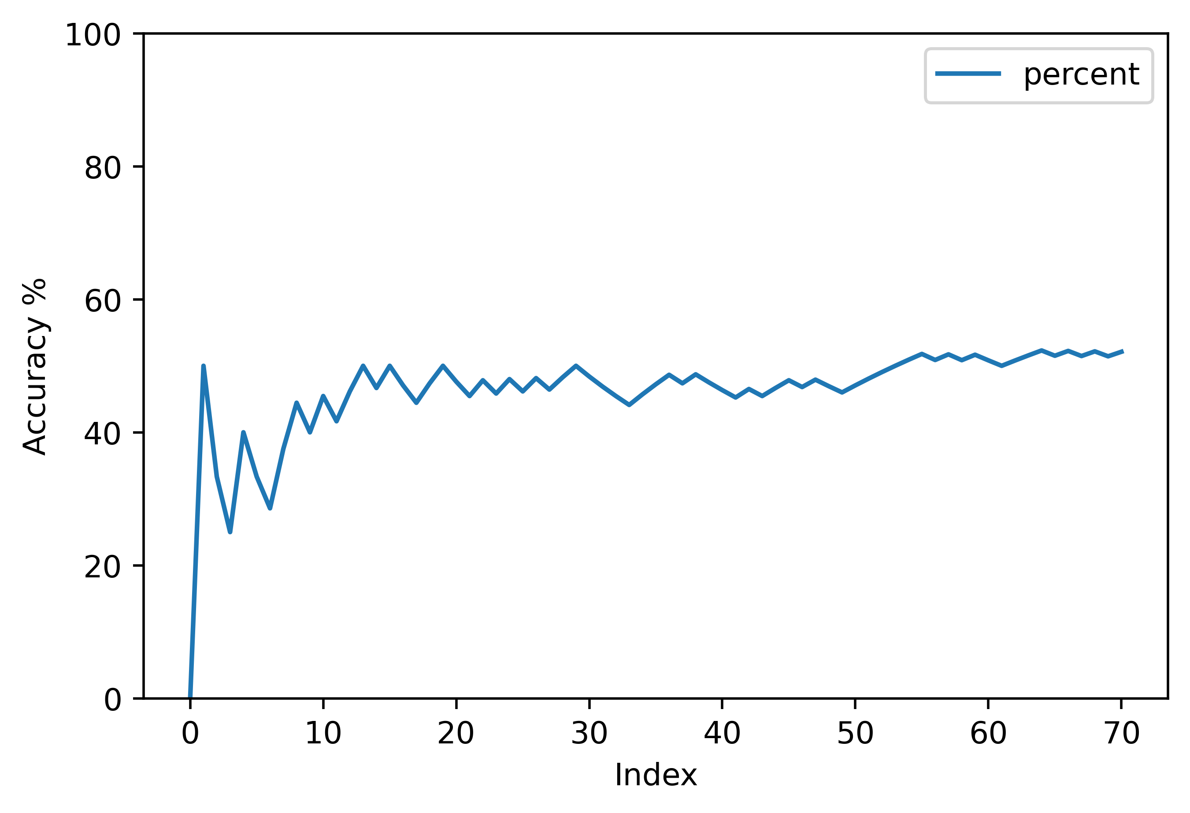
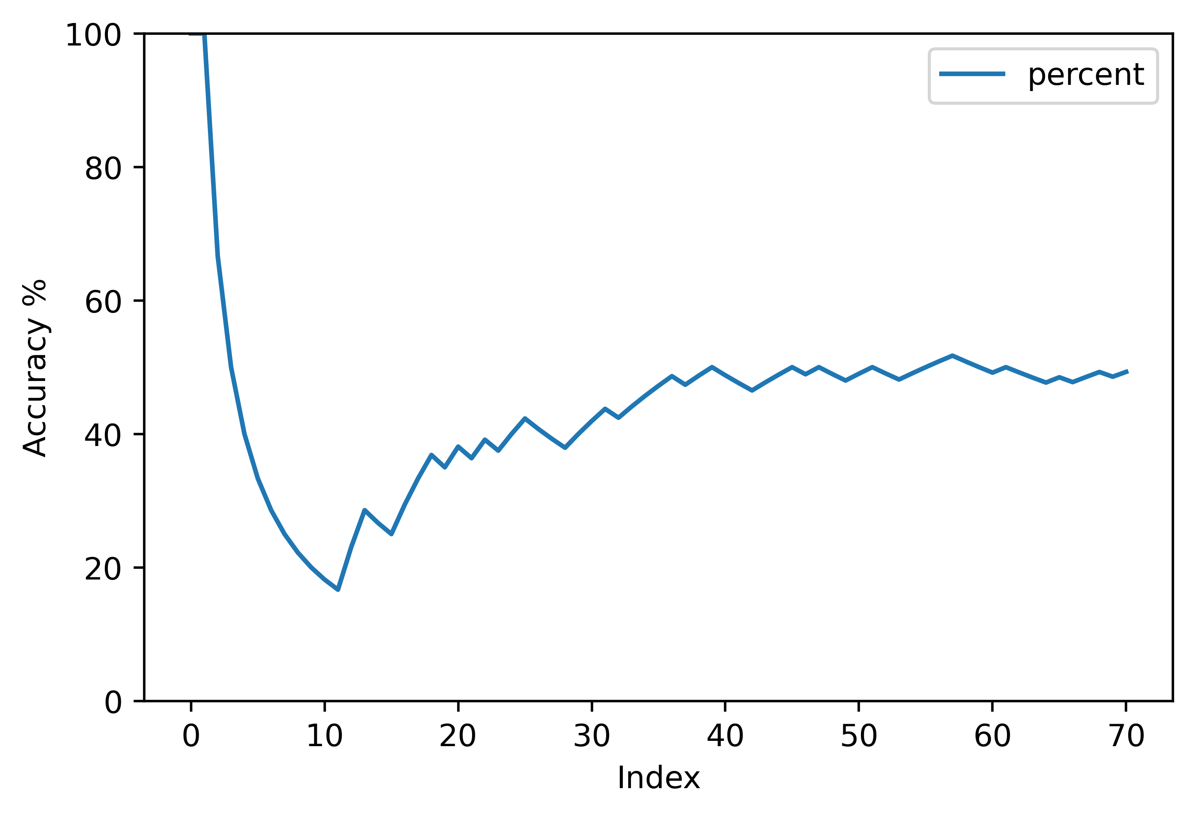
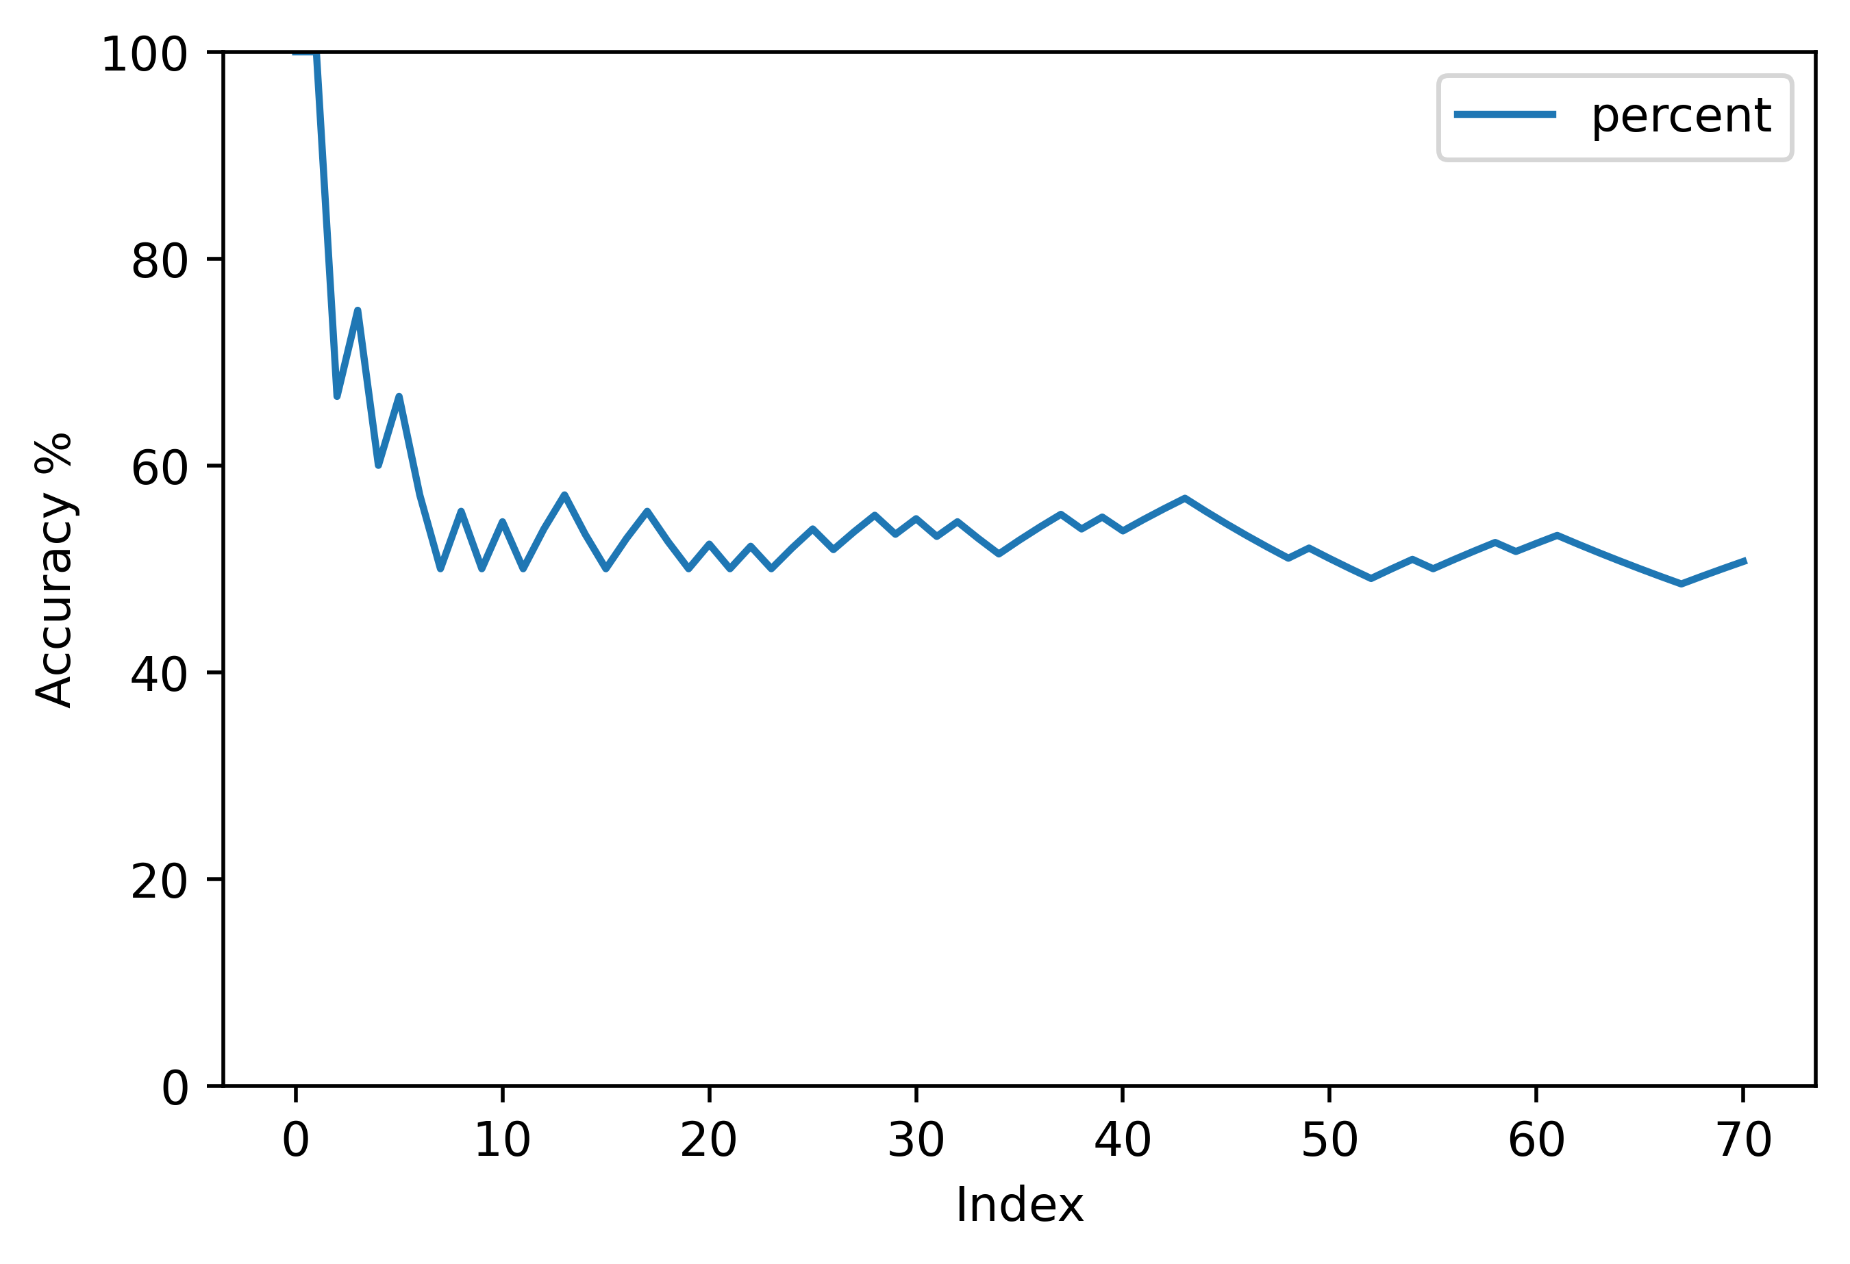
Hello
Results – Accuracy %

Slide 18
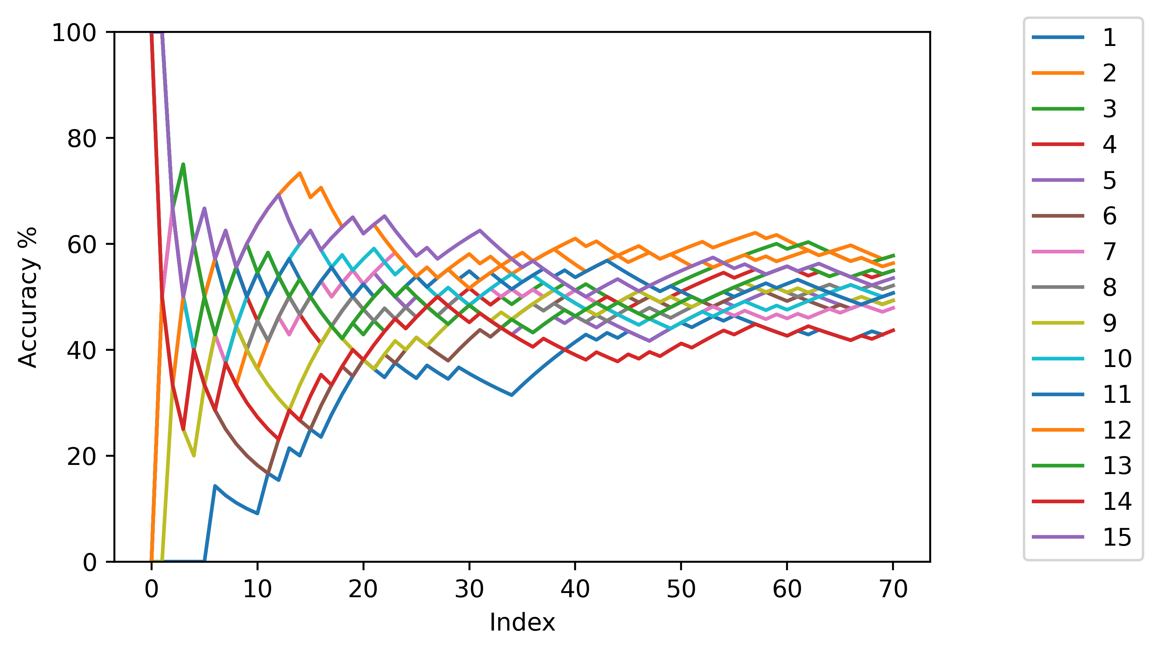

Slide 19
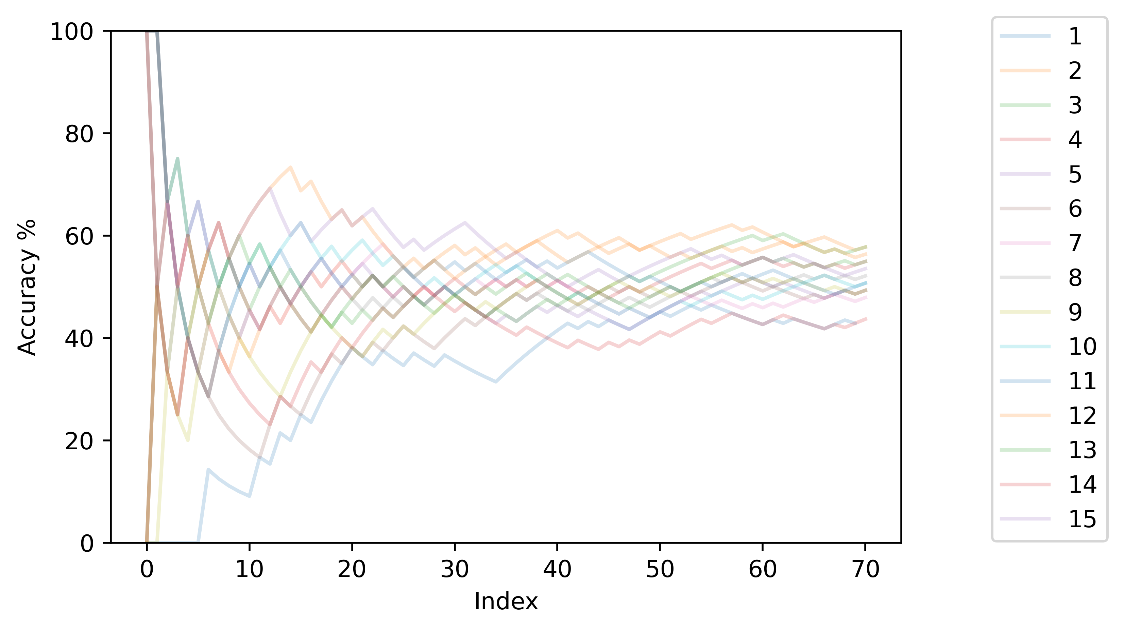

Slide 20
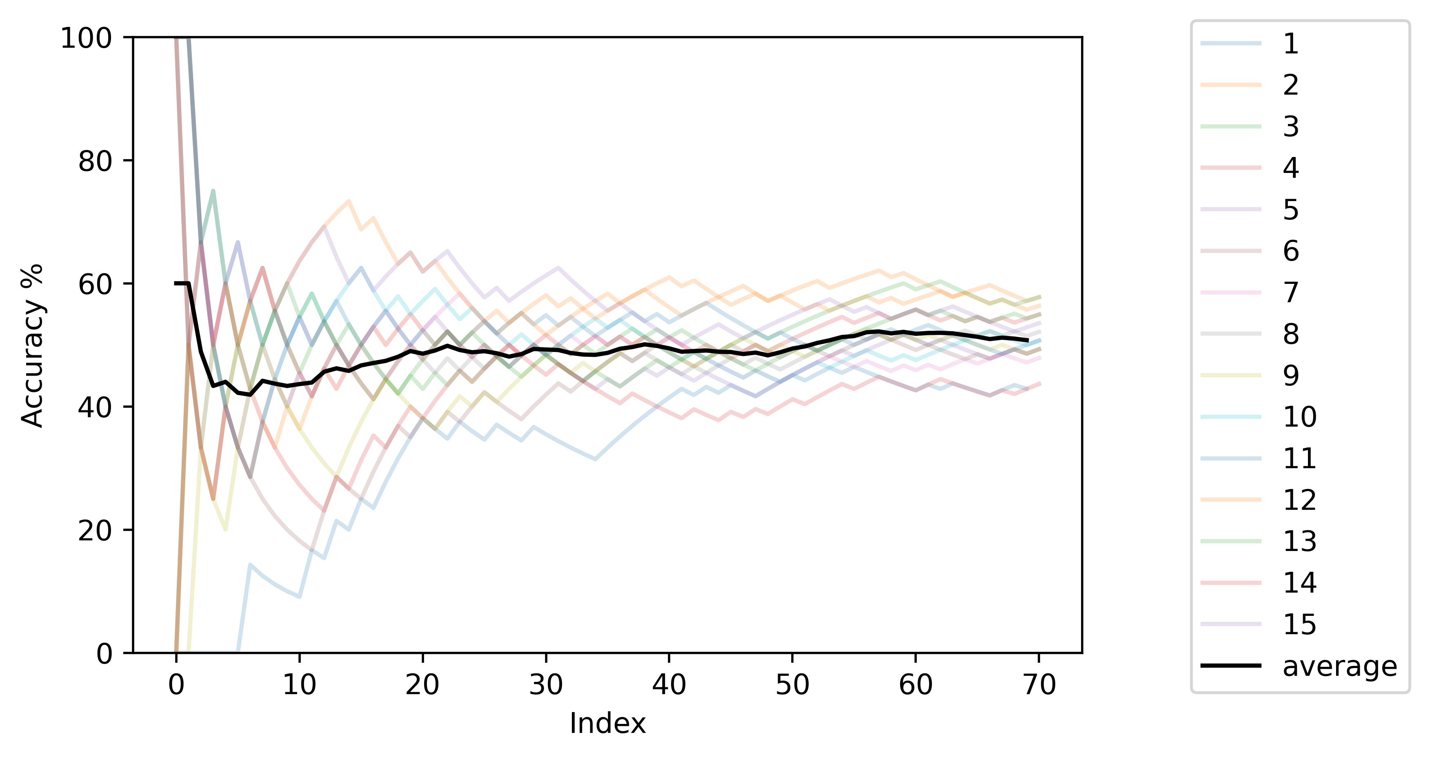

Slide 21
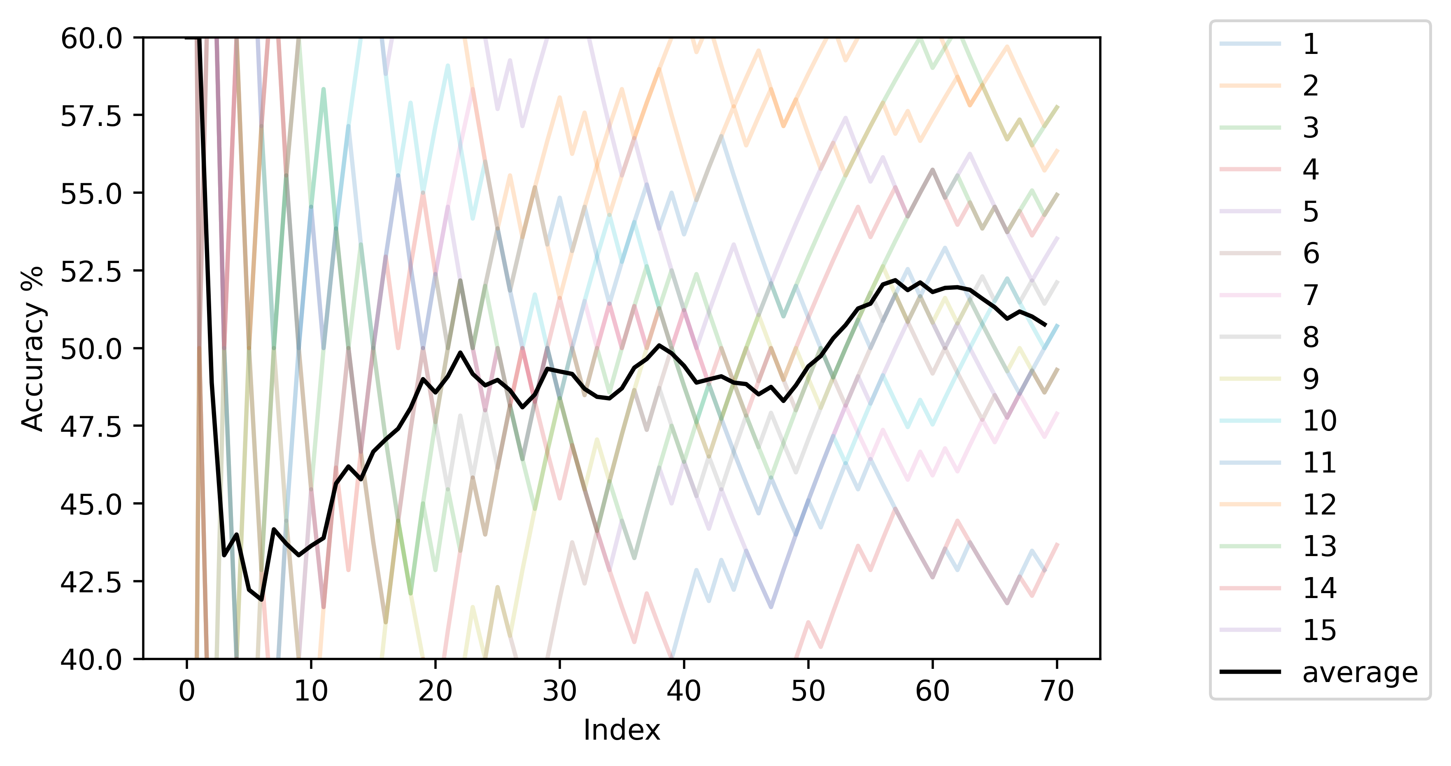

Slide 22
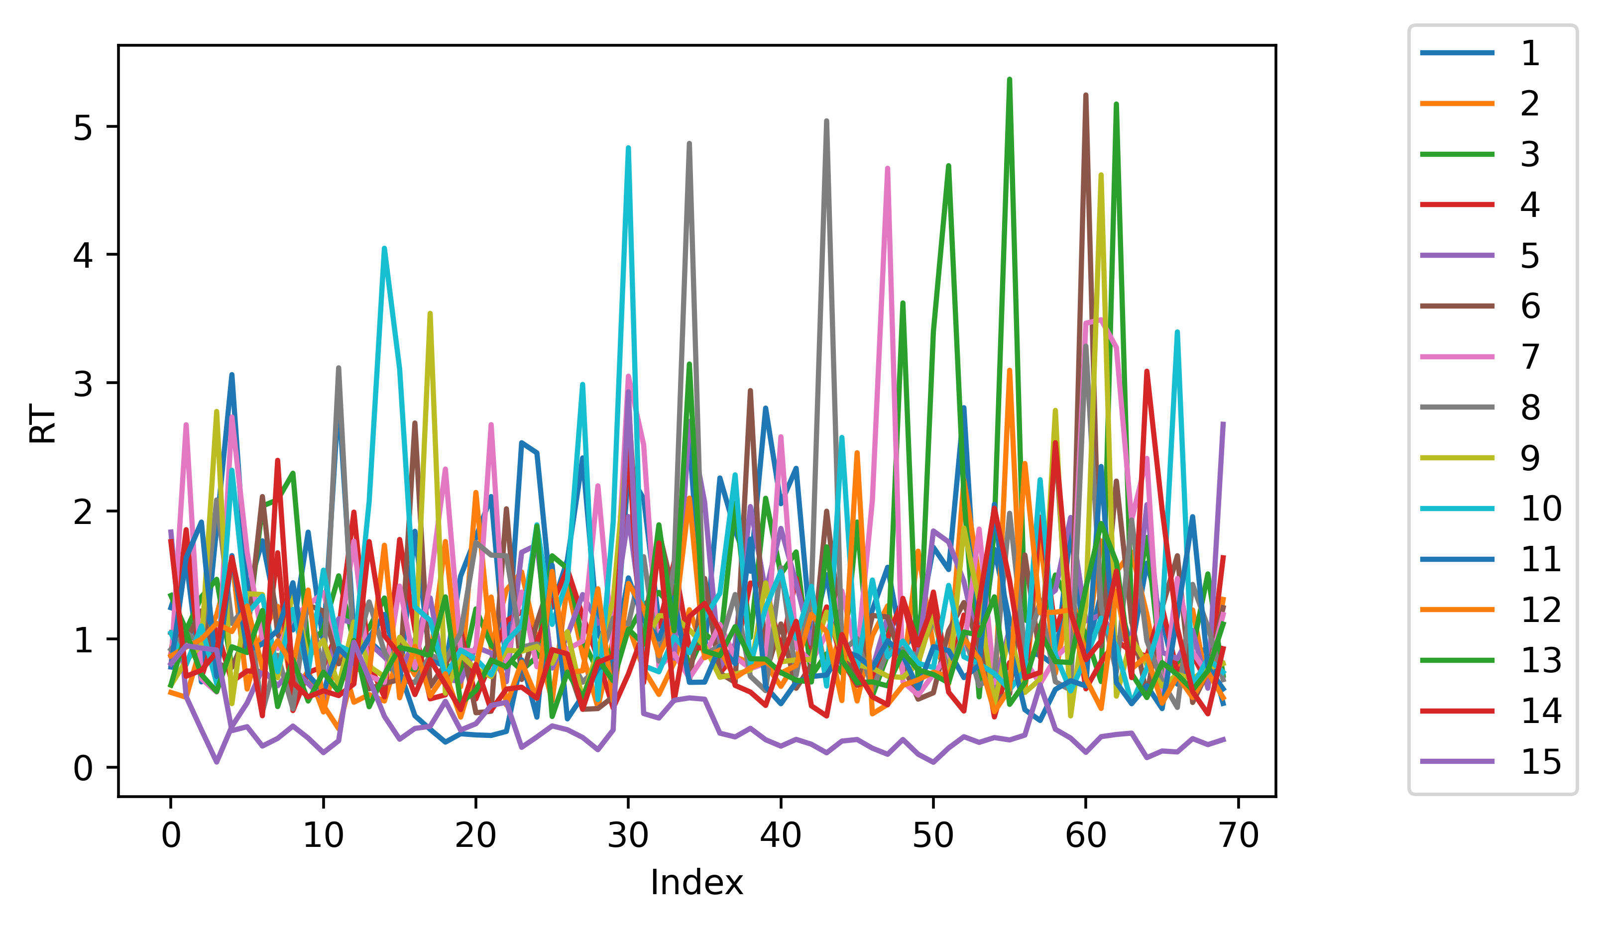

Slide 23
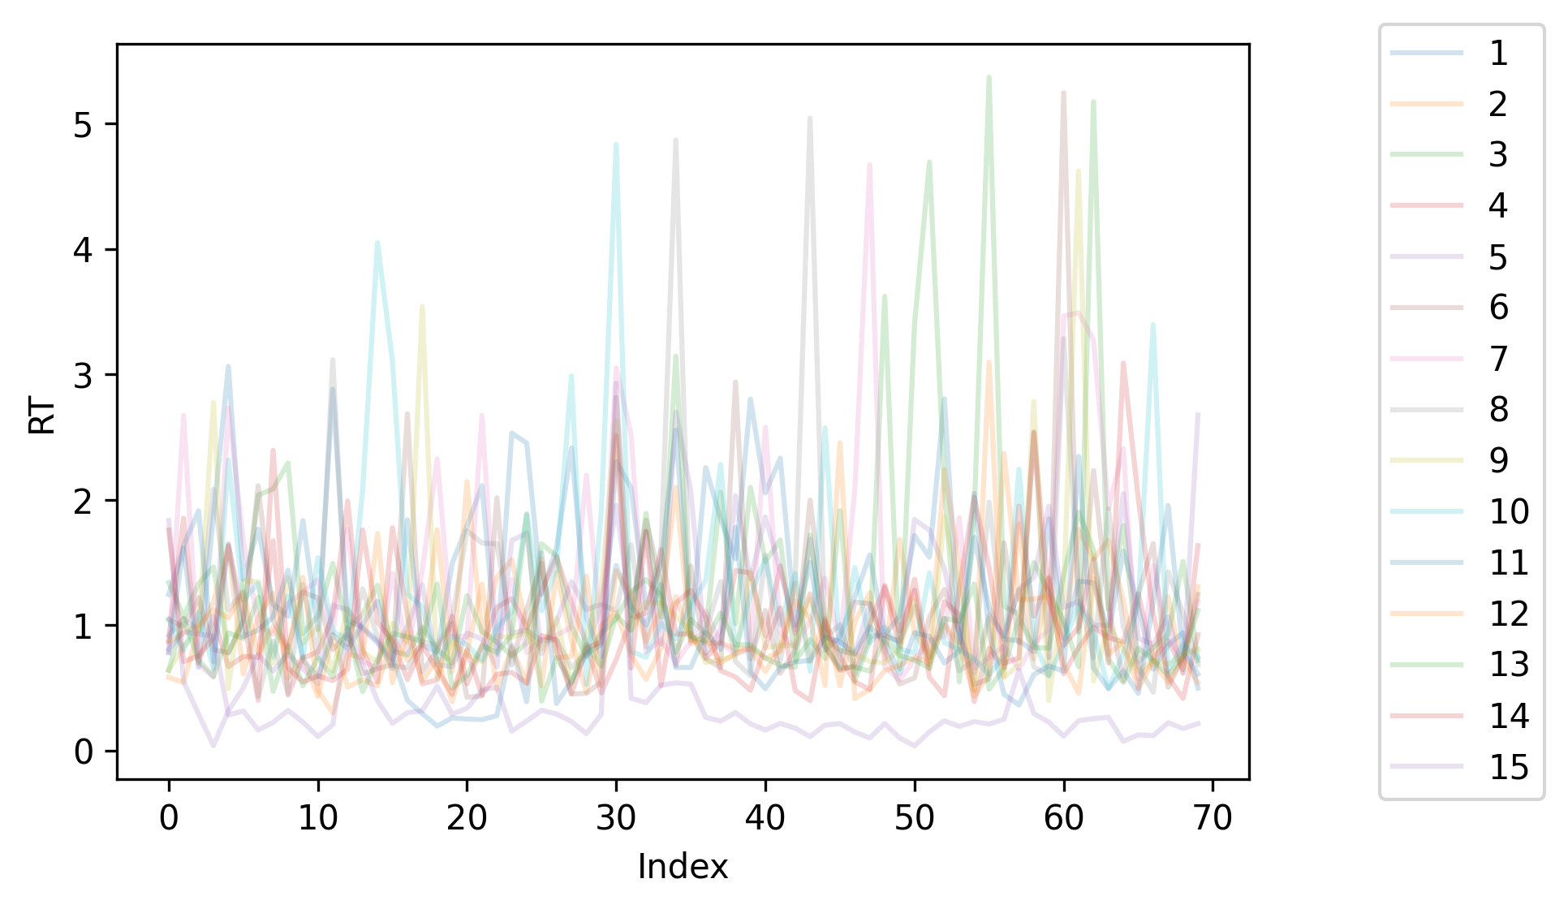

Slide 24
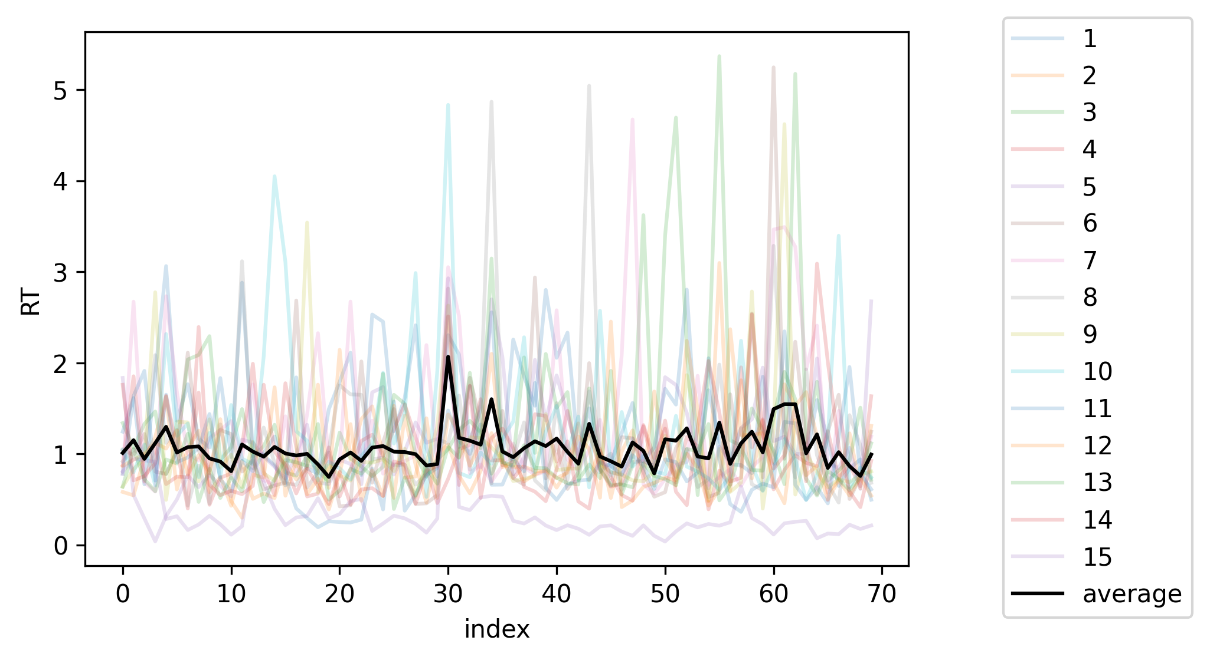

Slide 25
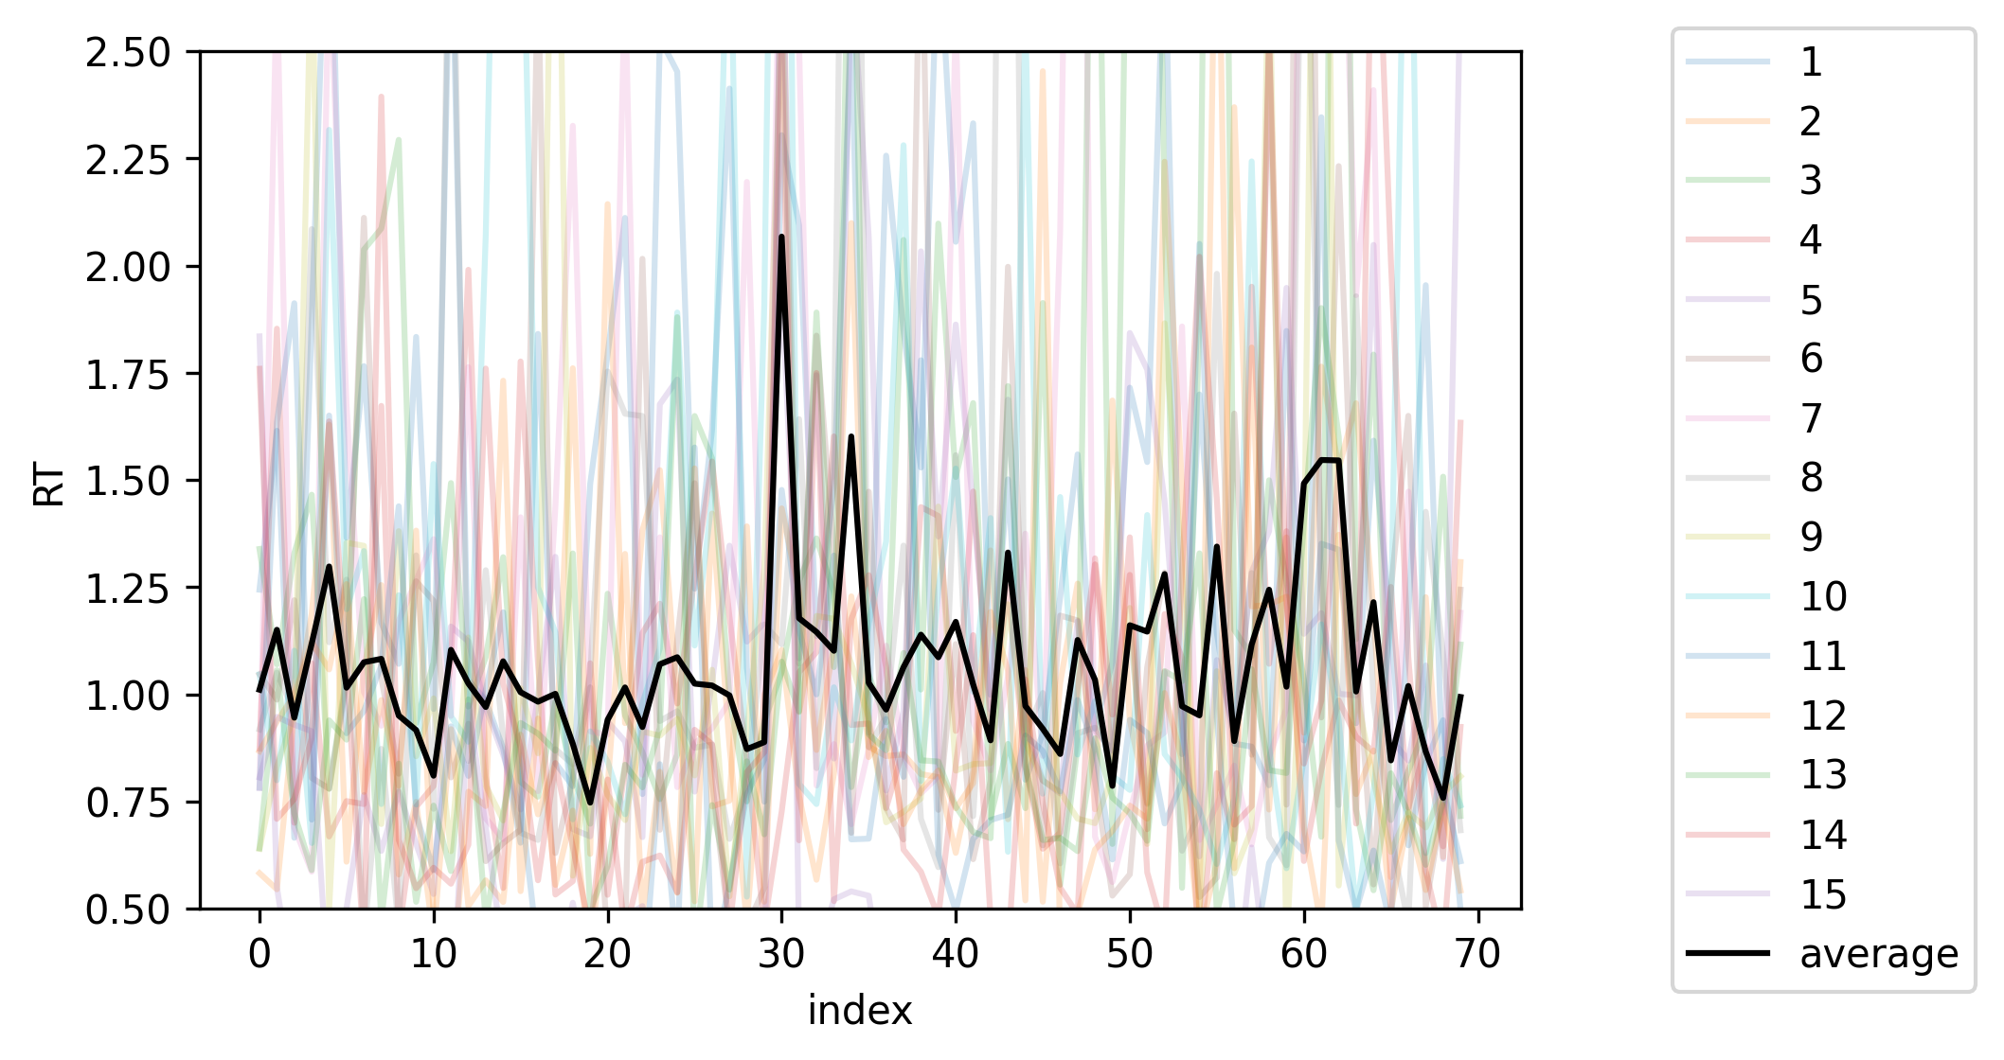
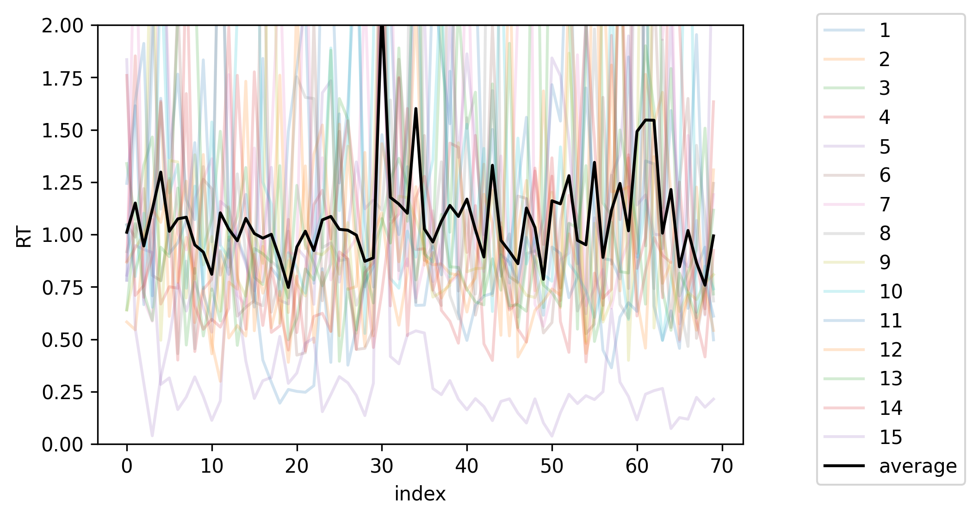

Slide 26
Do they correlate?

Slide 27
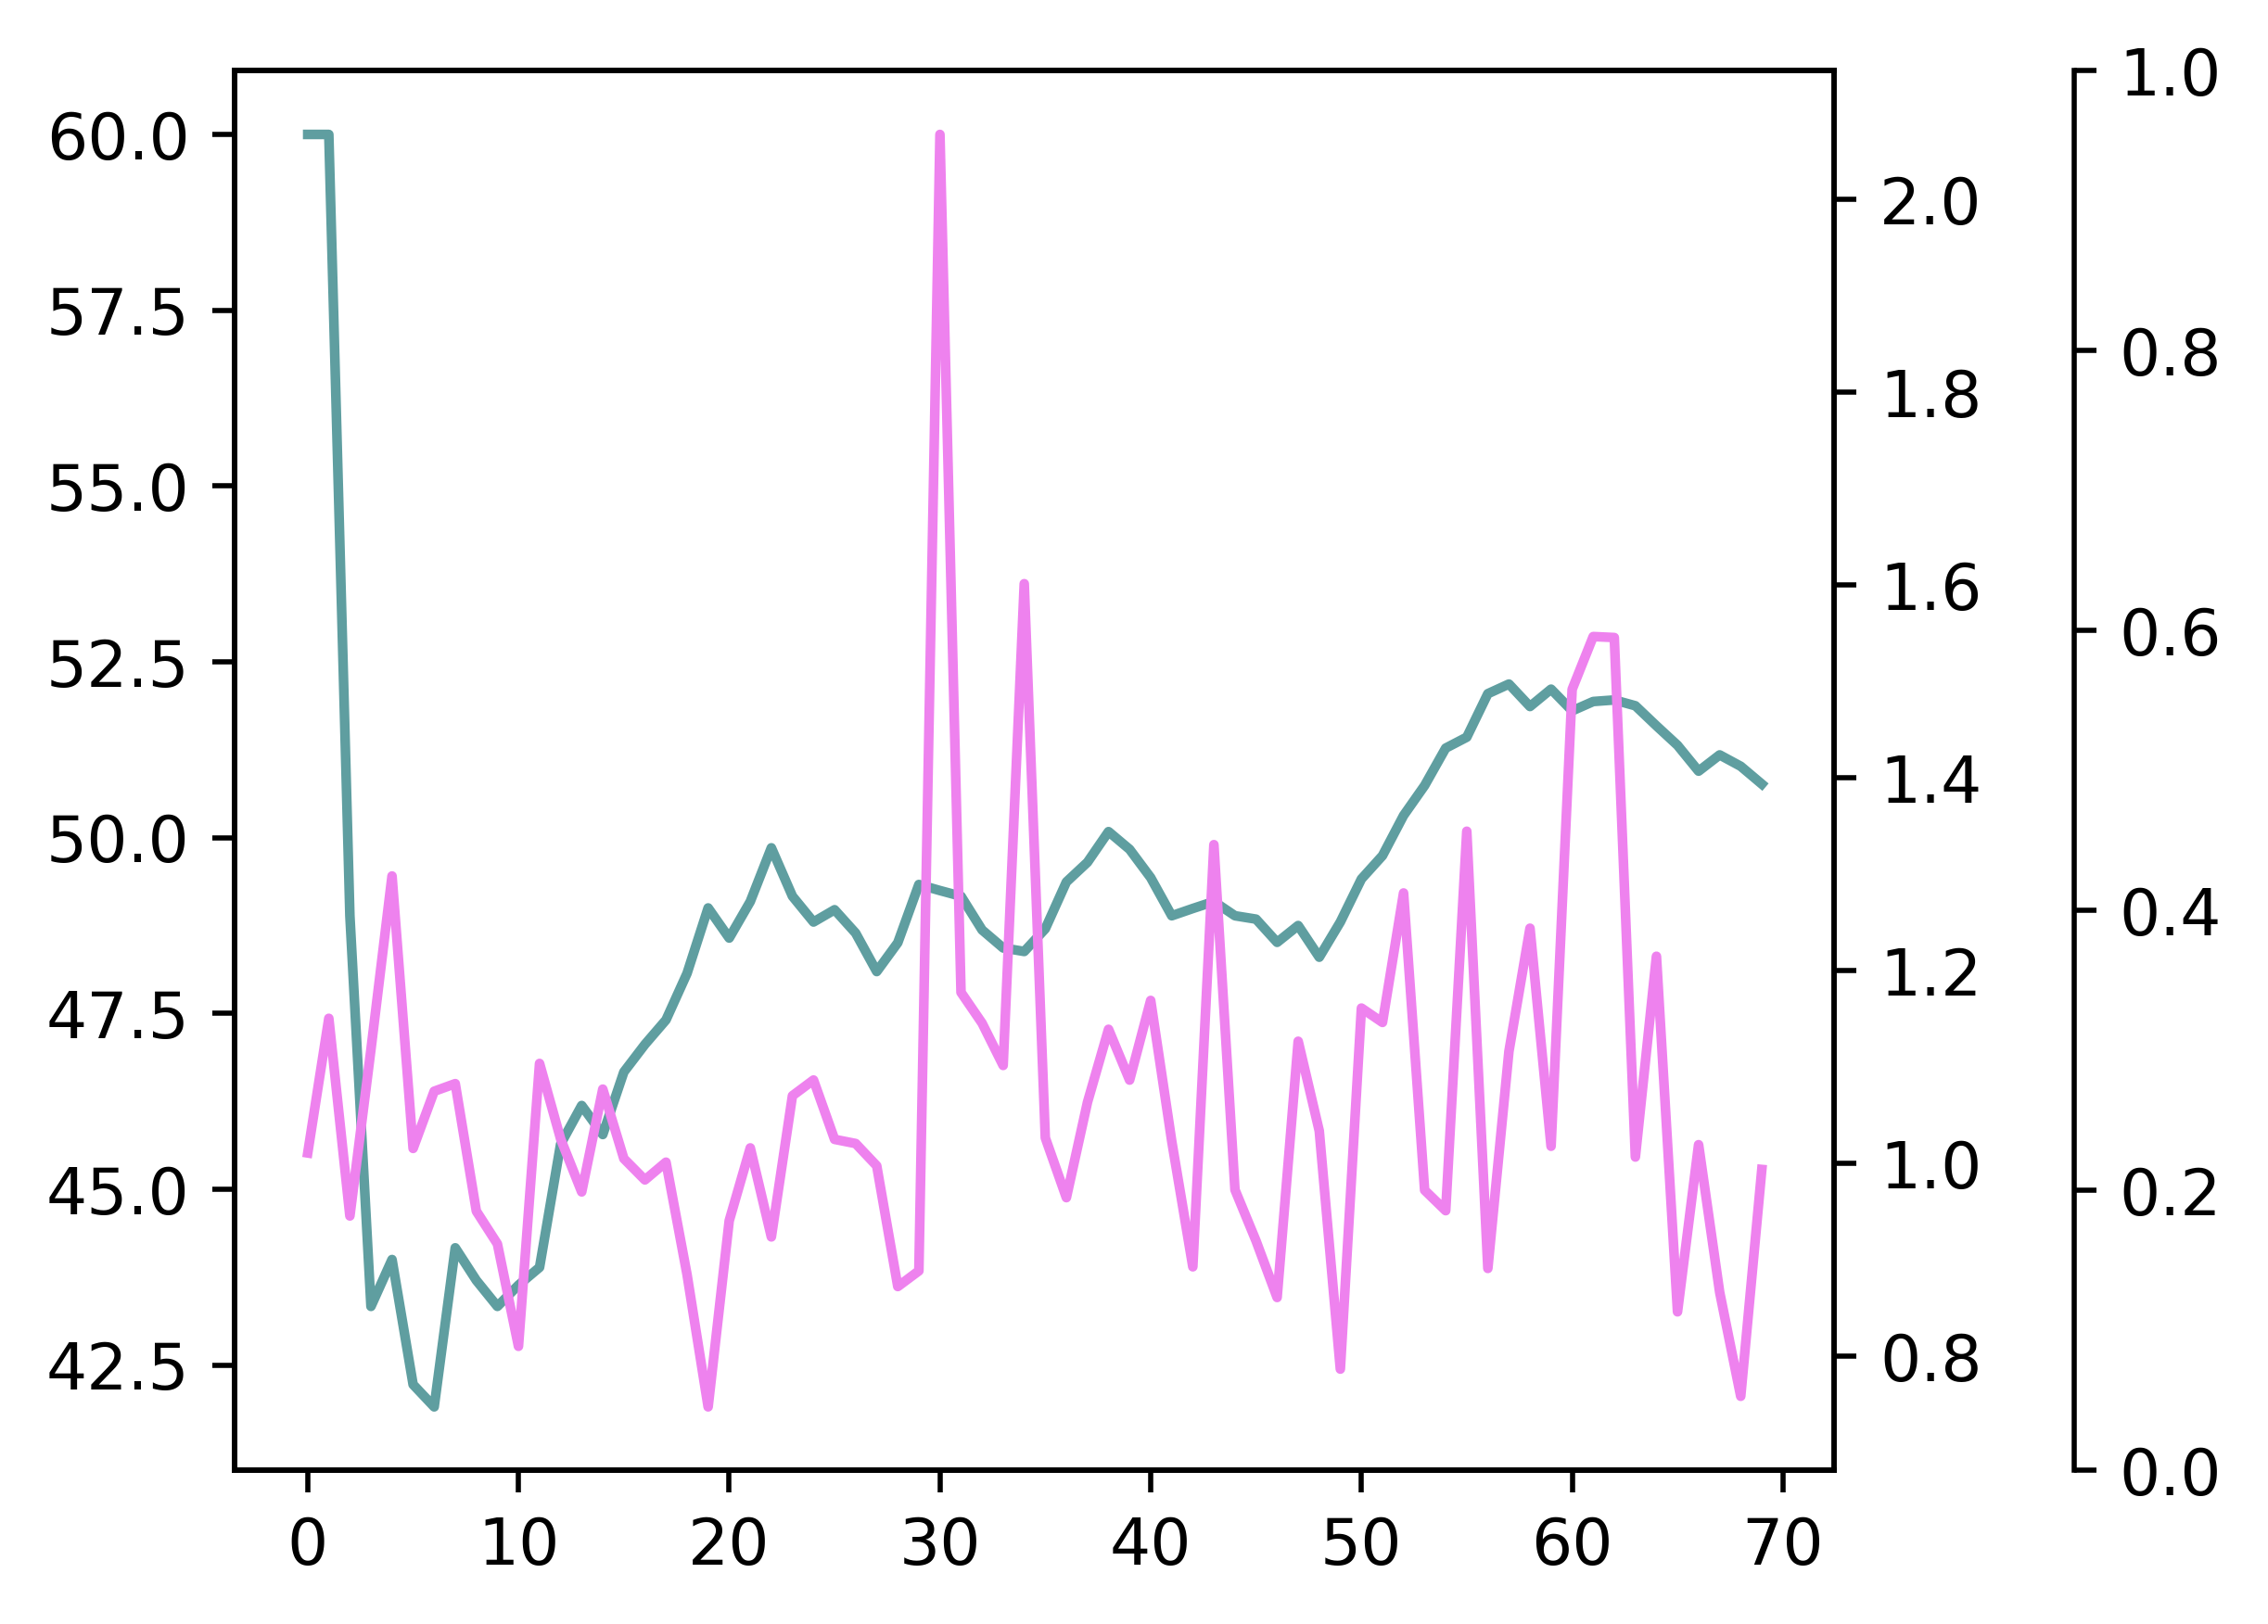

Slide 28
Conclusion

Slide 29
Conclusions
It takes time for a brain to get into flow of memorizing with VSTM (iconic memory).
It takes time to switch from memorizing inharmonious colors to harmonious colors and vice versa.
Switch within harmonious sets of different colors does not take much time.
With a little more time to react, harmonious colors are easier to remember based on accuracy% and participants’ feedback.

Slide 30
Limitations
One or maybe two participants were completing the experiment without any effort.
Participants reported black color being the easiest to see and guess. Taking into consideration that black color was displayed pretty frequently, accuracy% may be biased/inaccurate.
Some participants reported that at the start of the experiment, they often found it difficult not to misclick, meaning that accuracy% for the first 5-10 trials may not be accurate.

Slide 31
Limitations
One or maybe two participants were completing the experiment without any effort.
Participants reported black color being the easiest to see and guess. Taking into consideration that black color was displayed pretty frequently, accuracy% may be biased/inaccurate.
Some participants reported that at the start of the experiment, they often found it difficult not to misclick, meaning that accuracy% for the first 5-10 trials may not be accurate.

Slide 32
Limitations
One or maybe two participants were completing the experiment without any effort.
Participants reported black color being the easiest to see and guess. Taking into consideration that black color was displayed pretty frequently, accuracy% may be biased/inaccurate.
Some participants reported that at the start of the experiment, they often found it difficult not to misclick, meaning that accuracy% for the first 5-10 trials may not be accurate.

Slide 33
Limitations
One or maybe two participants were completing the experiment without any effort.
Participants reported black color being the easiest to see and guess. Taking into consideration that black color was displayed pretty frequently, accuracy% may be biased/inaccurate.
Some participants reported that at the start of the experiment, they often found it difficult not to misclick, meaning that accuracy% for the first 5-10 trials may not be accurate.

Slide 34
Questions?

